Slide 1
Previous Lecture
Whenever there is a potential difference between two points in a conductor…
… there is an electric field at those points
$$E=\frac{ΔV}{d}$$
Whenever there is an electric field in a conductor, there are moving charges
Youtube: Lecture 16: https://youtu.be/PzULPcejP4I
Lecture 17: https://youtu.be/f5Kx9Kja1ao

Slide 2
Current
OpenStax Chapter 20.1
Connecting wire across a potential difference results in current
Current flows from high potential to low potential
It is conserved in a wire
Also conserved at junctions

Slide 3
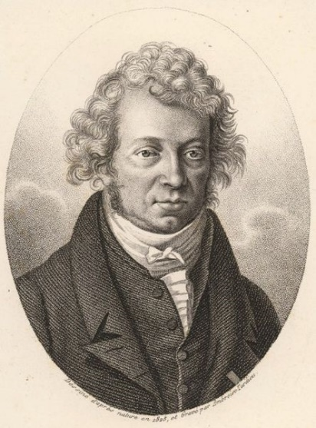
Moving Charges
We’ve focused on stationary charges and well defined motion of small groups of charges
When larger groups of charges are moving, we’ll focus on “current”
Current (I) is motion of charges
Charge that passes through
Current through surface
Time for that charge to pass by
SI unit: ampere (A); 1 A = 1 C / s
(often called “amp”)
http://en.wikipedia.org/wiki/File:Ampere_Andre_1825.jpg

Slide 4
How to start Current?
Inside Materials, Two Necessary Ingredients
Potential Difference
Means electric field and which leads to electric force
For isolated charges this is enough to get them moving
Path for charges to follow
Charges don’t spontaneously leave material so will flow through conductors
Can connect plates of capacitor, terminals of battery, etc.

Slide 5
What Moves in a Metal?
Are the moving charges protons, electrons, or both?
Experiments show that only electrons move
(this matches idea of conductor as “sea of electrons”)
BUT: current is considered to be flow of “positive charge carriers”
+++++++
–––––––
i.e. currents will be drawn going from high potential to low
(it is the convention used in current flow)
I
e–
This is opposite the actual motion of electrons

Slide 6
What Does Current Do?
If a wire is left connected long enough charged objects will discharge (battery will die, etc.)
While charges are flowing through a wire:
Wire Heats Up
Devices (like light bulbs) function
These two are closely related
Compass (that shows direction) readings change
(we’ll discuss this last one later in the course)

Slide 7
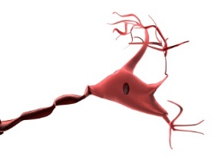
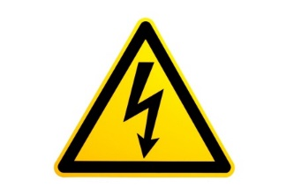
Places Currents Show Up
Nature:
Technology:
Lightning
Anything with a plug or battery
Hearing Aid
0.0001 A
10,000 A
Landline Phone
0.03 A
Phone Charger
0.1 A
Nerve Impulse
Light bulbs
0.5 – 1 A
0.00001 A
Toasters
10 A
Currents & You:
Detect
0.001 A
Hurt
0.01 A
Burns
0.1 A
Severe Burns
10 A
Lethal
0.5 A
If DC & across heart (<0.1 A if AC)

Slide 8
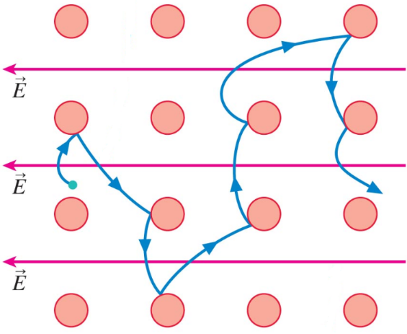
Motion of Charges
Electrons in any material at room temperature move around randomly, usually around fixed locations
If an electric field is applied, electrons try to move in a particular direction determined by the field
Electrons can interact with atoms and/or ions in the material
(i.e. collide and bounce off)
© 2010 Pearson Education, Inc.
Electrons have “drift velocity” opposite the direction of the electric field

Slide 9
Conservation of Current
Direction of E-Field
(& Current)
e–
For an electron to pass through the left ring but not the right, what would have to happen?
Violate concepts like Newton’s 2nd Law, Conservation of Mass, or Conservation of Charge
Conservation of Current: Any current going into a part of a wire comes out the other side

Slide 10
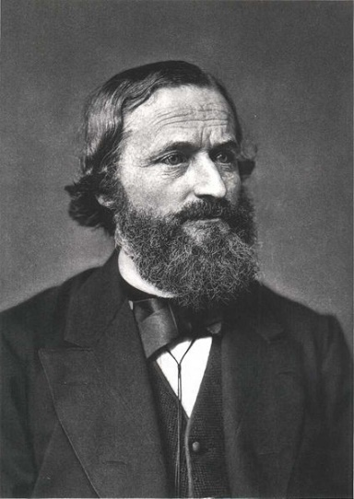
Kirchhoff’s Junction Law
Specific application of Conservation of Current
Analysis of what happens when two or more wires join together:
Current going into junction equals current going out
I₂
I₁
If I₁ = 2 A and I₂ = 0.8 A,
http://en.wikipedia.org/wiki/File:Gustav_Robert_Kirchhoff.jpg
then I₃ = 1.2 A
I₃

Slide 11
Using Junction Law
I₂ = 2 A
I₃ = ?
I₄ = 1 A
I₁ = 5 A
_{Junction}
I₅ = 3 A
2 A up
2 A down
5 A down
9 A up
9 A down
I flowing in = I flowing out
I₁ + I₂ + I₅ = I₃ + I₄
I₃ = (5 + 2 + 3) – 1 A
I₃ = 9 A

Slide 12
Using the Junction Law
I_{a} = 6 A
I_{y}
I_{x}
Choose a direction for I_{w}
(if calculated current is negative, then I_{w} is opposite to direction chosen)
I_{w}
I_{d} = 1 A
I_{b} = 3 A
I_{c} = 2 A
I_{z}
What is current I_{w}?
5 A, down
ΣI_{into junction} = ΣI_{out of junction}
I_{w} =
I_{w} = I_{b} + I_{c}
= 5 A
What is current I_{x}?
A. 7 A, right B. 3 A, right C. 5 A, right D. 2 A, right E. 4 A, left

Slide 13
Resistance
OpenStax Chapter 20.2
Resistance measures how hard it is for current to flow
Depends on material and shape
Increases with length, decreases with area

Slide 14
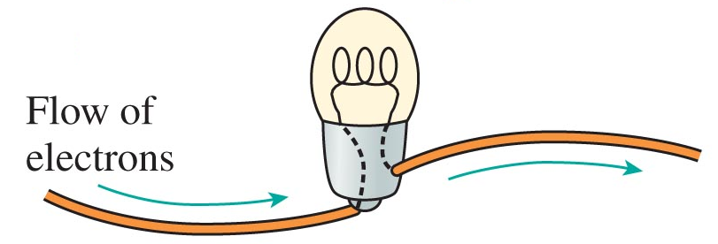
Conservation of Current and “Circuit Elements”
Circuit Element: any part of a circuit that isn’t just a wire
Do they “use” current up?
Short answer: no
But: electrons interact with matter as current flows (slide 8)
© 2010 Pearson Education, Inc.
(otherwise negative charge would build up until current stopped)
Current occurs because electrons are trying to get from one side of battery to the other

Slide 15
Changing Current
Two options to set up different currents :
Change potential difference ($Δ$V):
increase $Δ$V to increase current
Change what the current passes through:
Current will be much higher through metal than wood
Material
Lower current in Longer path (more stuff in the way)
Length
Bigger current for Broader path (more avenues to pass through)
Area

Slide 16
Resistance
Measure of an object’s ability to “resist” current,
(i.e. like friction to flow of charges)
(higher for poor conductors)
Resistivity of Material
Resistance of Object
Length of Object
Pretty much any object is a “resistor”
Cross Section Area of Object
SI Units of Resistance: ohm (Ω); 1 Ω = 1 V / A
1 m of 22 gauge Copper Wire:
1 m of 22 gauge Wood Dowel:
0.05 Ω
10⁹ Ω
all objects of Same Material have the Same Resistivity [SI Units of Resistivity: ohm meter (Ω.m)]

Slide 17
Analyzing Resistor
A 1.20 m long cylinder has a resistance of 0.064 Ω. If it is made of nichrome (ρ = 1.5 × 10^{–6} Ω.m), what is its radius?
First find cross sectional area
2.8 × 10^{–2} mm
1.0 mm
3.0 mm
4.0 mm
1.3 × 10⁵ mm
= 2.8 × 10^{–5} m²
Then find radius:
= 3.0 × 10^{–3} m

Slide 18
Conceptual Analysis of Resistor
Two cylinders are made of copper. The first has a length L₁, resistance R₁, and mass m₁. The second also has mass m₁ but has a length of 2 L₁. What is the second cylinder’s resistance?
R₁ / 4
R₁ / 2
R₁
2 R₁
4 R₁
Same material so they have the same resistivities and densities
Same density and mass means same volume
V_{olume} = A₁ L₁ = A₂ L₂
A₁ L = A₂ (2 L)
A₂ = A₁ / 2

Slide 19
Ohm’s Law
OpenStax Chapter 20.2
Resistance relates potential difference to current
Ohm’s Law: I = ΔV / R
Resistors obey Ohm’s Law for just about all voltages

Slide 20
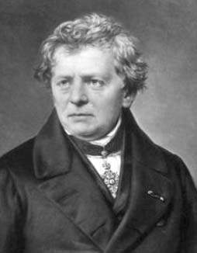
Potential, Resistance, and Current Ohm’s Law
Ohm
Ohm’s Law: relates resistance, potential and current:
Potential Difference across object
Current passing through object
http://en.wikipedia.org/wiki/File:Ohm3.gif
Resistance of object
Resistance is often measured by graphing current vs. potential and looking for the slope

Slide 21
Problem with Ohm’s Law
When two batteries are connected end to end, and a copper wire (with R = 0.15 Ω) is connected across them, the current through the wire is 20 A). What is the potential difference of one of the batteries?
3 V
1.5 V
133 V
6 V
266 V
+
–
+
–
(Find $ΔV$ and divide by 2)

Slide 22
Problem with Ohm’s Law [1]
When two batteries are connected end to end, and a 10 cm long copper wire is connected across them, the current through the wire is 3 A. What would be the current through a 30 cm long copper wire (with the same gauge as the first) connected across just one of the batteries?
1.0 V
0.5 A
4.5 A
9 A
1.5 A
First wire:
+
–
+
–
Second wire:
+
–

Slide 23
Problem with Ohm’s Law [2]
When two batteries are connected end to end, and a 10 cm long copper wire is connected across them, the current through the wire is 3 A. What would be the current through a 30 cm long copper wire (with the same gauge as the first) connected across just one of the batteries?
1.0 V
0.5 A
4.5 A
9 A
1.5 A
Suppose: potential difference of one battery = ε and, resistance of first wire = R₁
First wire
Second wire
Resistance
Potential Difference
ΔV₁ = 2ε
ΔV₂ = ε = ΔV₁ /2
Current

Slide 24
Problem with Resistance and Potential
Two 1.5 V batteries are connected end to end with a wire made of copper (ρ = 1.7 × 10^{–8} Ωm) connected from the positive terminal of one to the negative terminal of the other. If the wire is 11 cm long and has a diameter of 0.08 mm (approximately 40 gauge wire; A = 5.0 × 10^{–9} m²) what will the current through the wire be?
6.2 nA
1.2 nA
0.15 mA
4.0 A
8.1 A
+
–
+
–
Note: Batteries are potential sources, not current sources
(current depends on both battery potential and resistance in circuit)

Slide 25
Wires
Metal Wires can be treated like resistors with very low resistance
An ideal wire is one that has zero resistance
(so, potential difference across an ideal wire is also zero regardless of current, because V = I R)
Real wires have resistances so low we’ll assume that they’re 0 Ω
Superconductors actually do have zero resistance
Current once started will never stop in a superconductor

Slide 26
Battery vs. Wire Potential Differences
A battery has a potential difference of ΔV_{batt} (often called ε)
If a wire is connected to the terminals, what is its potential difference ΔV_{wire}?
A second wire would also have ΔV_{wire} = ΔV_{batt}
+
–
How is potential measured?
by comparing two probes of voltmeter
Voltmeter can’t tell what it measures potential of: ΔV_{wire} = ΔV_{batt}

Slide 27
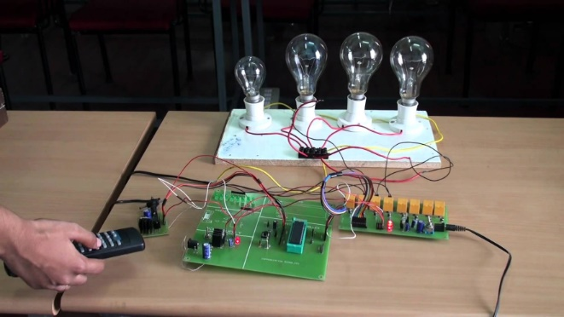
Circuits
OpenStax Chapter 20.2, 21.1

Slide 28
Electric Circuits
Network of electric components
Electric components affect:
- potential difference (a.k.a. voltage)
($ΔV or V)$
- current (I)
- resistance (R)
… and other quantities

Slide 29
Some Electric Components
Battery / cell: creates voltage
note: battery voltage is also called EMF (electromotive force)
Resistor:
creates resistance
(e.g. bulbs, motors, engines, …)
Wire:
conducts current
- usually made of metal
- assumed to have zero resistance
Positive Terminal
Negative Terminal
Switch: breaks or completes circuit
Open switch
Closed switch

Slide 30
Circuit Examples
Circuit with single resistor:
$$I$$
Battery voltage $ε$
Single resistor of resistance R
Current I travels from +ve to –ve terminal (slide 5), flowing through R on the way
$$+$$
$$ε$$
$$R$$
$$−$$
Circuit with multiple resistors and a switch:
Closed switch
Open switch
$$R_{1}$$
$$R_{2}$$
$$R_{1}$$
$$R_{2}$$
Current flows through both R1 and R2
Current flows entirely through R2 (zero current flows through R1)

Slide 31
Circuit Examples
The circuits in the boxes below are equivalent
(because the same currents travel through the same components located on the same segments)
$$R_{1}$$
$$R_{2}$$
$$R_{1}$$
$$R_{2}$$

Slide 32
Comparing Circuit Diagrams
Which of these is a different circuit from the others?
a.
b.
c.
d.
e.

Slide 33
Resistors in Series and Parallel
Resistors in series: current passes sequentially through the resistors (does not branch out)
Resistors in parallel: current branches out
Resistors in series and parallel:
$$R_{3}$$
R₁ and R₂ are in series with each other
R₁ and R₂ are in parallel with R₃
$$R_{2}$$
$$R_{1}$$

Slide 34
Potential in a Circuit: Potential Across a Battery (measured with a voltmeter)
Battery creates a potential difference $ε$ between its +ve and –ve terminals
i.e. V_{+ve} – V_{-ve} = $ε$
The potential at –ve terminal is assumed to be 0 V
therefore: V_{+ve} = $ε$
e.g. a battery of 1.5 V has potential of 0 V at the –ve terminal
and 1.5 V at +ve terminal, so that potential difference is 1.5 V
$$0 V$$
$$ε$$
$$+$$
$$−$$

Slide 35
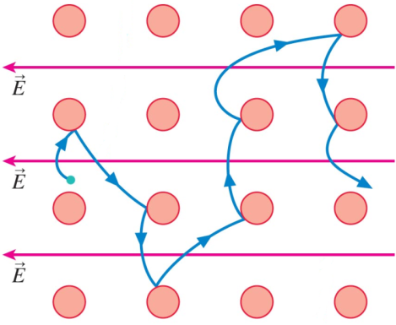
Potential in a Circuit: Potential Across a Resistor
As current flows through a resistor, potential dissipates/drops across the resistor [slide 14], because electrons lose energy upon collision
$potential=ε$ (connected directly to +ve terminal)
$$ε$$
$$R$$
$potential=\frac{ε}{2}$ (halfway across resistor)
$$0 V$$
$potential=0$ (connected directly to -ve terminal)
Note: potential does not change across wires because resistance of wires is zero [slide 25]

Slide 36
V, I, R Calculations in Circuits
Kirchhoff’s Current Law (Junction Law) [slide 10]
$$I_{in}=I_{out}$$
Ohm’s Law [slide 20]: V = I R
Kirchhoff’s Voltage Law (Loop Rule)
In a closed circuit (i.e. loop), the sum of voltage drops across all components add up to the battery voltage
$$V_{R1}$$
$V_{R1}, V_{R2} :$ voltage drops across R₁ and R₂
Kirchhoff’s Loop Rule:
$V_{R1}+V_{R2}= ε$
$$R_{1}$$
$$ε$$
$$R_{2}$$
$$V_{R2}$$

Slide 37
V, I, R: Resistors in Series
$$V_{1}$$
$$I_{1}$$
$I_{1}$ and $I_{2}$:
Kirchhoff’s Junction Law: $I_{in}=I_{out}$
(everywhere in the circuit)
Therefore: $I_{1}=I_{2} (=I)$
(because $I_{1}$ flows into R₂ and $I_{2}$ flows out)
$$R_{1}$$
$$ε$$
$$R_{2}$$
$$V_{2}$$
$$I_{2}$$
$R_{1}$ and $R_{2}$:
Ohm’s Law (for the circuit): $ε=IR_{eq}$
(R_{eq} is the circuit’s equivalent resistance)
Kirchhoff’s Loop Rule: $ε=I\left(R_{1}+R_{2}\right)$
$\text{Substituting}: R_{eq}=R_{1}+R_{2}$
$V_{1}$ and $V_{2}$:
Ohm’s Law: $V_{1}=IR_{1}$ , $V_{2}=IR_{2}$
Kirchhoff’s Loop Rule:
$$ε=V_{1}+V_{2} ⇒ ε=I(R_{1}+R_{2})$$
Summary:
Current is the same through all resistors in series
Resistance equivalent is the sum of individual resistances
Higher resistance => Higher voltage drop across resistor

Slide 38
V, I, R: Resistors in Parallel [1]
Potential across resistors in parallel:
$$ε$$
$$ε$$
$$ε$$
$$ε$$
$$ε$$
$$ε$$
$$R$$
$$R_{2}$$
$$R_{1}$$
$$R_{3}$$
$$R_{2}$$
$$R_{1}$$
$$0 V$$
$$0 V$$
$$0 V$$
$$0 V$$
$$0 V$$
$$0 V$$
${ΔV}_{R}=ε$ – 0 = $ε$
${ΔV}_{R}=ε$ – 0 = $ε$
${ΔV}_{R}=ε$ – 0 = $ε$
Potential across resistors in parallel remains constant regardless of the number of resistors connected
If there are N resistors connected in parallel, every resistor will have the same voltage drop:
$$V_{1}=V_{2}=V_{3}= …=V_{N}= ε$$

Slide 39
V, I, R: Resistors in Parallel [2]
$$I_{0}$$
Kirchhoff’s Junction Law : $I_{0}=I_{1}+I_{2}$
[slide 38] : $ε=V_{1}=V_{2}$
Ohm’s Law:
$I_{0}=\frac{ε}{R_{eq}} , I_{1}=\frac{ε}{R_{1}}$ , $I_{2}=\frac{ε}{R_{2}}$
$\text{Substituting}:$
$$\frac{ε}{R_{eq}}=\frac{ε}{R_{1}}+\frac{ε}{R_{2}}$$
$$⇒ \frac{1}{R_{eq}}=\frac{1}{R_{1}}+\frac{1}{R_{2}}$$
$$ε$$
$$V_{2}$$
$$R_{1}$$
$$R_{2}$$
$$V_{1}$$
$$I_{2}$$
$$I_{1}$$
$$I_{0}$$
Summary:
Voltage is the same across all resistors in parallel
$\frac{1}{R_{eq}}=$ sum of individual $\frac{1}{R}$ ’s
Higher resistance => Lower current through resistor

Slide 40
In General for N Resistors
Equivalent Resistance (R_{eq}): a single resistor that has the same resistance as a group of resistors
Series
Adding more resistors increases R_{eq}
Parallel
Adding more resistors decreases R_{eq}

Slide 41
Conceptual Problem
Rank the potential at each of the points assuming that the wires are ideal (note: resistors are in both series and parallel).
A
B
V_{A} = V_{C}
+
–
V_{D} = V_{E}
C
V_{B} = V_{F}
F
D
E
V_{A} = V_{C} > V_{D} = V_{E} > V_{B} = V_{F}

Slide 42
Example: Loop Rule
2 Ω
What is the current in this circuit and which way does it point (clockwise or counterclockwise)?
3 V
1.5 V
Assume current is either CW or CCW (in this example, we assumed CCW)
Start at bottom right and count up potential changes (going CCW)
I
Apply the loop rule (sum of V = 0):
3 Ω
$−1.5 V+V_{2Ω}+3 V+V_{3Ω}$ = 0
$⇒ −1.5 V+2I+3 V+3I$ = 0
$⇒ 1.5 V+5I$ = 0
$⇒ I=\frac{−1.5}{5}=−0.3 A$ (-ve $⇒$ CW)
Note: if the answer were positive, current would have been CCW (i.e. same as assumed direction)

Slide 43
Example: Group of Resistors [1]
What is the equivalent resistance (R_{eq}) of this group of resistors?
10 Ω
10 Ω
30 Ω
Step 1: Find R_{eq} of the 10 Ω resistors in series
10 Ω
20 Ω
R_{eq1} = (10 + 10) Ω = 20 Ω
Redraw circuit
Step 2: Find R_{eq} of the 20 Ω resistors in parallel
R_{eq_1}= 20 Ω
30 Ω
$\frac{1}{Req2}$ = $\frac{1}{20} +\frac{1}{20}$
=> R_{eq2} = 10 Ω
10 Ω
20 Ω

Slide 44
Example: Group of Resistors [2]
Redraw circuit
Step 3: Find R_{eq} of the remaining resistors, now all in series
R_{eq2}= 10 Ω
30 Ω
R_{eq} = (10 + 10 +30) Ω
= 50 Ω
10 Ω

Slide 45
Example 2: Group of Resistors [1]
What is the potential difference across the circled resistor?
2.0 V
4.0 V
6.7 V
12 V
20 V
10 Ω
10 Ω
20 Ω
30 Ω
10 Ω
Same set of resistors as previous
R_{eq} = 50 Ω
20 V

Slide 46
Example 2: Group of Resistors [2]
Draw simplified circuit (using R_{eq} of the circuit):
R_{eq} = 50 Ω
20 V
I
Find current through the R_{eq}:
Use Ohm’s Law for the above circuit: A = 0.4 A

Slide 47
Example 2: Group of Resistors [3]
Draw full circuit:
10 Ω
10 Ω
R_{eq_2} = 10 Ω
[slide 44]
20 Ω
30 Ω
For the parallel resistors in the box, each part has same ΔV_{R}
[slide 38]
i.e. V_{Req2} = V_{20Ω}
10 Ω
20 V
I= 0.4 A

Slide 48
Example 2: Group of Resistors [4]
What is the potential difference across the circled resistor?
Find V_{Req2} (Ohm’s Law):
Redraw using R_{eq2}
30 Ω
V_{Req2} = I R_{eq2} = 4.0 V
2.0 V
4.0 V
6.7 V
12 V
20 V
V_{20Ω} = V_{Req2} = 4.0 V
R_{eq2}=10 Ω
10 Ω
I= 0.4 A
20 V
Note: using Ohm’s law on the 20 Ω resistor, the current through it can be calculated

Slide 49
Tips for Analyzing Combination of Resistors
Identify any groups in series
Find equivalent resistance for each group
Redraw circuit with R_{eq} in place of the group
Identify any groups that are in parallel
Find equivalent resistance for each group
Redraw circuit with R_{eq} in place of the group
Repeat until all resistors combined as much as necessary and/or possible
If looking for current or potential drop across a resistor
Use Ohm’s Law at each
Remember: series means same current, parallel means same potential drop across each element
Equivalent resistor must have same total current and total potential difference

Slide 50
Measuring Voltage
Voltmeters measure potential difference
Probes go on either side of element being measured
Therefore: voltmeter is connected in parallel
That means, voltage across voltmeter is the same as the voltage across element
Symbol:
V in a circle
V
Thing Being Measured

Slide 51
Measuring Current
Ammeters measure charges flowing through them
They get inserted into branch where current is being measured
Therefore: ammeter is connected in series
Symbol:
A in a circle
Branch Being Measured
That means, current through ammeter is the same as the current through element
A
Rest of Circuit

