Slide 1
Chapter 11
Introduction to Human Geography (2018)
University of North Georgia Press
Industry
Lecture Notes by Dorrell, Henderson, Lindley, & Connor.

Slide 2
Chapter 11: Industry
STUDENT LEARNING OUTCOMES
By the end of this section, the student will be able to:
Understand: the origins and diffusion of industrial production
Explain: the impact of industry on places
Describe: the industrial basis of modern cultures
Connect: industrialization, technology, the service sector and globalization
Introduction to Human Geography (2018). Dorrell, Henderson, Lindley, & Connor. University of North Georgia Press.

Slide 3
Chapter 11: Industry
CHAPTER OUTLINE
11.1 Introduction
11.2 Marx’s Ideas
11.3 Factors for Location
11.4 The Expansion and Decline of Industry
11.5 Global Production
11.6 Summary
Introduction to Human Geography (2018). Dorrell, Henderson, Lindley, & Connor. University of North Georgia Press.

Slide 4
11.1 Introduction
The industrial revolution
    A series of improvements in industrial technology that transformed the process of manufacturing goods about 200 years ago
      Widespread (but originated in England)
      Social, economic, political inventions (not just about machinery!)
      Diffused gradually
    Home-based manufacturing exchanging human labor for machine labor
    Not a single point in time, still unfolding across time and space
    The entire purpose of Industrialization is to be CHEAPER!!
De-industrialization
  Dramatic decrease in industrial jobs occurring in North America and Western/Northern Europe from the 1980’s onward
  Same time period saw industrial jobs increase dramatically in the Global South
  Causes
    Globalization of production (relocation of manufacturing)
    Automation
Notes:
Source: https://genographic.nationalgeographic.com/human-journey/

Slide 5
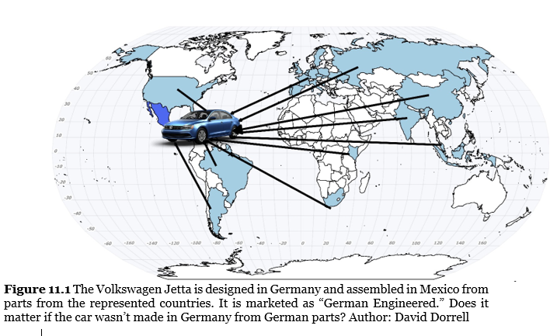
Globalization of Production (Example of Post-Fordism in Action

Slide 6
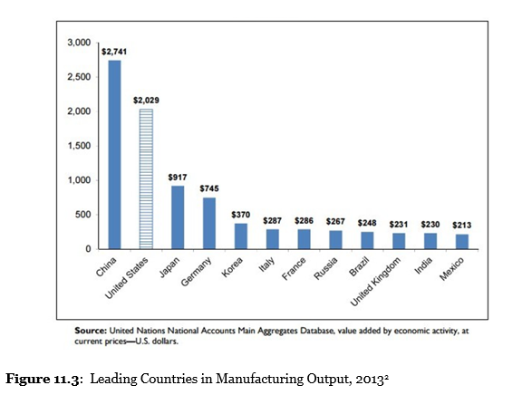
De-Industrialization has resulted in fewer industrial jobs in the US, Germany, Italy, and the UK, while manufacturing jobs in China have steadily increased. How do we interpret such realities in the 21st century?
2 modes of industrial production
Fordism
  Assembly line
  Simplified tasks
  High wages
  Division of labor
2) Post-Fordism
  Spatial distribution of production to multiple locations
  Seeks lowest wages/costs
  Less tied to specific location

Slide 7
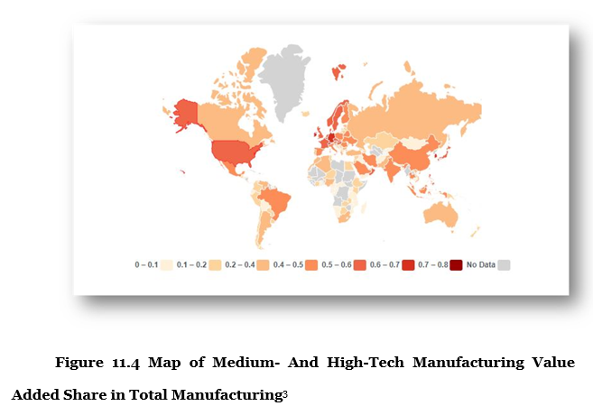
11.2 Industrial Geography

Slide 8
The rate of profit for any product will always fall
11.2 Marx’s Ideas on Production
Law of the tendency of the rate of profit to fall is “in every respect the most important law of modern political economy”
Competitors, increased efficiency, lower cost of inputs tend to reduce cost of production resulting in lower price, leading to lower profits
Producers respond by seeking lower cost of production, sometimes choosing to reduced production cost by ‘offshoring’
  The movement of production and/or registered location of production to a different jurisdiction (usually into a different country, where costs are lower)
Notes:
Source: https://genographic.nationalgeographic.com/human-journey/

Slide 9
Industrial location for production consists of:
11.3 Factors of Production
Land (Material): raw materials, energy, cost of land, tax structure, availability of other material inputs
Labor: considerations include pay rate, skill levels, total available labor force, other costs associated with the workforce (e.g. unions, benefits packages, etc.). Mechanization of labor has displaced significant number of workers in manufacturing in the late 20th & early 21st century
Capital: availability of capital (money) including loans, investors, government incentives
Transportation: manufacturing seeks to locate where transportation costs for inputs and for the finished product are minimized. E.G. automobile manufacture in the U.S. tends to locate in a narrow north to south strip between Michigan and Georgia to minimize transportation costs.
  Ubiquitous inputs
  Less common inputs
  Importance of standardization & containerization
Notes:
Source: https://genographic.nationalgeographic.com/human-journey/

Slide 10
2 Types of Production:
11.3 Factors of Production
Bulk Gaining – locates near the market (e.g. modular homes
Bulk Reducing – locates near the source of inputs (e.g. near steel)
Notes:
Source: https://genographic.nationalgeographic.com/human-journey/

Slide 11
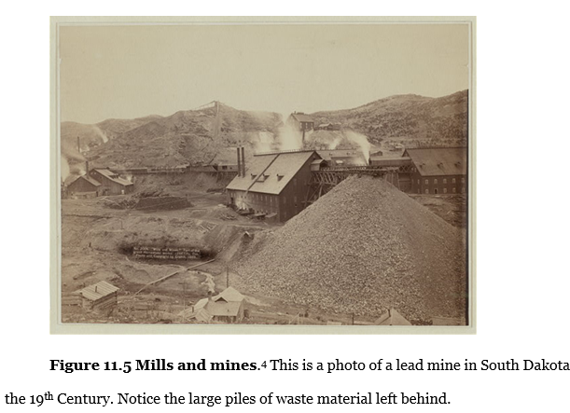
11.3 Factors of Production
Early manufacturing always located close to the essential raw materials, but 21st century production locations have changed dramatically. What has changed to allow for production location to change so dramatically?

Slide 12
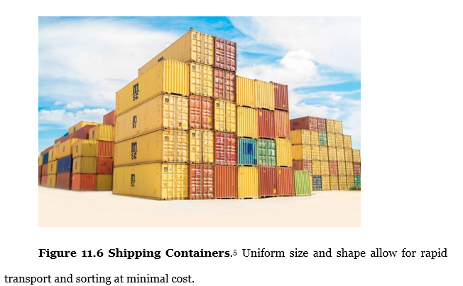

Slide 13
Transnational Corporations (TNC’s)
11.4 The Expansion and Decline of Industry
TNC’s attempt to operate seamlessly across multiple countries in an attempt to:
  Serve customers in multiple locations
  Minimize transportation cost
  Minimize cost of production
Many TNC’s enjoy higher annual revenues than the entire size of most countries, giving private sector organizations more power than many countries’ governments
Significance of Foreign Direct Investment (FDI)
Notes:
Source: https://genographic.nationalgeographic.com/human-journey/

Slide 14
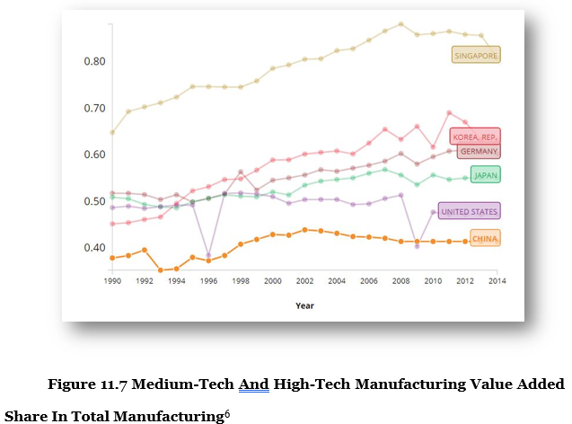
11.4 The Expansion and Decline of Industry

Slide 15
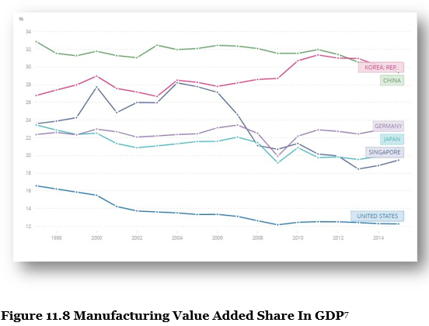
11.4 The Expansion and Decline of Industry

Slide 16
11.5.1 Hegemony and Economic Ascendency
11.5 Global Production
Rapid industrialization tends to bring higher than average wages to certain countries, allowing a society to transition from an agrarian based economy to one that derives higher value from manufacturing
Industrialization requires heavy involvement/support of national government, but occurs differently in different places
Hegemony refers to the dominance and control of one group over another. In the case of manufacturing, those countries with high industrial capacity and output were able to exert considerable power and influence over those without high levels of manufacturing output
Several (previously) poorer countries have managed to ‘ascend’ the economic ladder in the late 20th century specifically by increasing manufacturing capacity and output
Notes:
Source: https://genographic.nationalgeographic.com/human-journey/

Slide 17
Space, Production, & Trade
11.5 Global Production Part II
Locations of production have shifted dramatically. China has increased its productive capacity more and any other single place, due in large part to the role of its government to provide:
  A large pool of cheap labor
  A large amount of capital investment – both domestic and foreign direct investment
  A simplified system that attracts for business interests
Manufacturing income rises fast during early industrialization, but tends to wane over time, requiring countries to create new kinds of opportunities for labor. Each country that industrializes must also plan for a post-industrial economic system to create jobs and sustainable income.
21st Century trade has increased to unprecedented levels, such that supply chains create dependencies across multiple countries for the production of even relatively simple outputs. Coordination of such trade has become a hallmark of production networks in recent decades.
Notes:
Source: https://genographic.nationalgeographic.com/human-journey/

Slide 18
Sectors of the Economy
11.5.4 Deindustrialization & Services
Primary (agriculture, fishing, and mining)
Secondary (manufacturing and construction)
Tertiary (service related jobs)
  Public
  Business
  Consumer
    The Gig Economy
      Workers as contractors instead of employees
      Irregular work schedules
      Elimination of benefits (health insurance, minimum wage, payroll taxes, etc.
      Examples: Uber driver, AirBNB host, blogger, YouTuber
The BIG Question: Can deregulated 21st century service jobs provide economic upward mobility in the future?
Jobs in the Tertiary Sector have reconfigured the spaces and places of work for millions of people. Examples?
Notes:
Source: https://genographic.nationalgeographic.com/human-journey/

Slide 19
11.6 Summary
Industrial development continues to be reconfigured as TNC’s seek lower costs of labor, materials, and transportation.
Many developed countries seek to recapture some of the manufacturing jobs that were previously lost to the globalization of production
The Industrial Revolution never ended. It simply continues to impact and dramatically transform more countries, places, and people than ever before.
Notes:
Source: https://genographic.nationalgeographic.com/human-journey/

Slide 20
11.X Documentary Film List for Industry
Blood in the Mobile (2004).
  https://video.alexanderstreet.com/watch/blood-in-the-mobile-mining-in-the-congo
Black Gold (2006)
  https://video.alexanderstreet.com/watch/black-gold
Made In China (2007)
  https://ggc.kanopy.com/video/made-china
Smokestack Nation: The Industrial Titans (2015)
  https://ggc.kanopy.com/video/america-gilded-age-and-progressive-era-smoke
Automation Will Crash Democracy: A Debate
  https://fod-infobase-com.us1.proxy.openathens.net/p_ViewVideo.aspx?xtid=165893&tScript=0

Slide 21
Chapter 11 END
Introduction to Human Geography (2018)
University of North Georgia Press
INDUSTRY
Lecture Notes by Dorrell, Henderson, Lindley, & Connor.

