Slide 1
Light
Light is an electromagnetic wave
Involves oscillations of electric and magnetic fields
Next segment of class will be describing electricity and magnetism so we can return to light towards the end
Youtube: https://youtu.be/q0VL0z7-RyM

Slide 2
Reminders about Vectors
When a symbol has an arrow ( ) over it, it is a vector
Vectors have magnitude and direction
Changing either changes the vector
Some vectors talked about in PHYS 1111K:
Displacement, velocity, acceleration, force, momentum, torque
Some scalars talked about in 1111K:
distance, speed, energy, pressure

Slide 3
Using Vectors
Components and Magnitude
A vector’s components are vectors which lie in the x and y directions and add together to create the vector:
y
Measure how much of the vector is in the x and how much is in the y direction
θ
x
Magnitude

Slide 4
Electric Charges
OpenStax Chapter 18

Slide 5
Start of Electricity
Objects can be made to exert long range forces on each other
When they interact through friction:
Fur on rubber / plastic:
Can cause attractions
Touch plastic to metal:
Can get repulsions
At least three types of matter interaction:
1. no long range interaction
2. attraction
3. repulsion

Slide 6
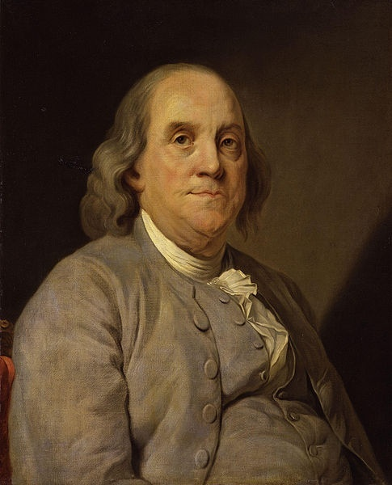
Charges
Three types of matter:
Positive
SI Units of charge: Coulomb (C)
Typical symbol: q
Electrically charged:
Likes repel
Static Shock ~ 10^{–6} C
Negative
Lightning Bolt ~ 15 C
Opposites attract
http://en.wikipedia.org/wiki/File:Benjamin_Franklin_by_Joseph_Siffred_Duplessis.jpg
AA Battery (total) ~ 10⁺³ C
B. Franklin defined positive charge as how glass became charged when rubbed with silk
Neutral
Don’t attract each other

Slide 7
OpenStax Chapter 18.1
Charge
  An object’s electrical charge is determined by the number of protons and electrons it has
  Charge is conserved (it cannot be created or destroyed)

Slide 8
Source of Charge
Normal matter is made of atoms
Nucleus made of protons and neutrons
Surrounded by electrons
Protons are called positive because of Franklin’s convention (p⁺)
Electrons are negative (e–)
Electrons and Protons have the same magnitude charge:
e = 1.602 ×10^{–19} C
Neutrons are neutral (n⁰)

Slide 9
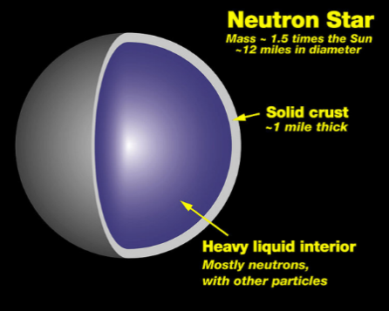
Charge in Objects
A neutral object has an equal number of protons and electrons
This number is almost always NOT zero
A neutral, adult human has on the order of
10²⁸ protons and electrons!!!!
http://en.wikipedia.org/wiki/File:Neutron_star_cross_section.jpg
To charge an object you must either add or remove protons or electrons
Neutron stars are almost entirely made of neutrons
(MUCH easier to remove or add electrons)
Particles come from or go to other object (charge is conserved)

Slide 10
Types of Materials
Conductor
Atoms’ valence electrons are fairly free to move
“Sea of electrons”
Charges can flow across a conductor
Touching charged conductors to each other will cause charges to balance out
Examples: metals, tap water

Slide 11
Touching Charged Conductors
Three identical metal spheres have charges of q_{A} = 4 C, q_{B} = 0 C, and q_{C} = –4 C. If sphere A is touched to sphere B, removed, and then touched to sphere C, what is A’s final charge?
–4 C
–1 C
0 C
4 C
2 C
How many excess electrons / protons is this?
6.25 × 10¹⁸ electrons

Slide 12
Touching Charged Conductors
Three identical metal spheres have charges of q_{A} = 4 C, q_{B} = 0 C, and q_{C} = –4 C. If sphere A is touched to sphere B, removed, and then touched to sphere C, what is A’s final charge?
A
B
C
Initially
4 C
0 C
–4 C
–4 C
–1 C
0 C
4 C
2 C
A & B equalize
2 C
2 C
–4 C
A & C equalize
–1C
2 C
–1 C
How many excess electrons / protons is this?
Charge (Q) = Number of electrons (N) * Charge per electron (–e)
= 6.25 × 10¹⁸ electrons

Slide 13
Types of Materials
Insulators
Electrons are bound pretty tightly to their atoms
they do not move around easily
Charges usually do not flow across an insulator
(touching an insulator to two charged objects will not cause the charge to equalize)
Examples: rubber, wood, paper, distilled water

Slide 14
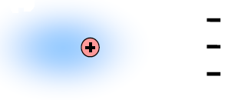
Charged Object Near Neutral One
Conductor
Insulator
Electrons flow towards or away from charged object
Electrons shift towards or away from charged object
+++++
Neutral Metal
- - - - -
Opposite charges are closer than like charges
+ + + + +
Electric force depends on distance
In either case objects are attracted to each other

Slide 15
Polarization
When charges in an object are separated this is called polarization of charge
Why does attraction between polarized neutral object and charged object occur?
+++++
Neutral Metal
- - - - -
Opposite charges are closer than like charges
Electric force depends on distance
+ + + + +

Slide 16
Coulomb’s Law
OpenStax Chapter 18.3
Coulomb’s Law
  Gives force exerted by one charged object on another
  Proportional to the charges
  Inversely proportional to the square of the distance between the two charges

Slide 17
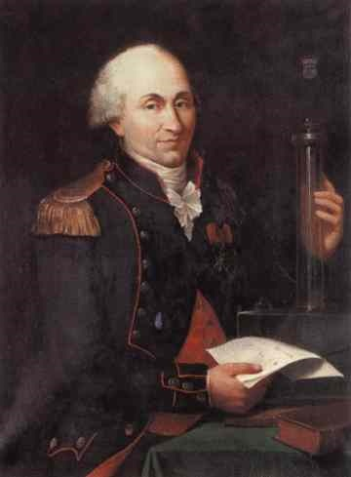
Coulomb’s Law
Describes electrical force of one charged particle on another
r
q₁
q₂
k = 8.99 x 10⁹ N m² / C²
Direction:
towards each other for opposite charges
away from each other for like charges
http://en.wikipedia.org/wiki/File:Charles_de_coulomb.jpg
To get net electric force on a particle, add up forces acting on it from all other particles

Slide 18
Using Coulomb’s Law in 1D
If the force on B is 5.6 nN to the left, what is the charge of B?
y
q_{A}
q_{B}
x
= 2.0 × 10^{–9} C
q_{A} = + 5.0 nC and is at the origin
q_{B} at (4.0 m, 0 m)
Force on B is in negative x-direction so force between charges is attractive, B is negative
q_{B} = –2.0 nC

Slide 19
Scaling Problem with Forces
Charged objects A and B are held near each other and then released. Doing which of the following (independently) would quadruple B’s initial acceleration?
This would quadruple a_{B}
This would increase a_{B}, but not quadruple it
This would decrease a_{B}
This would not change a_{B}
A
I. Double each charge
II. Quadruple A’s charge
III. Quadruple B’s charge
IV. Double the charge’s initial separation
V. Quadruple the charge’s initial separation
VI. Halve the charge’s initial separation
VII. Divide the charge’s initial separation by 4
VIII. Halve both object’s masses
IX. Divide A’s mass by 4
X. Divide B’s mass by 4
A
Reminder: Newton’s 2nd Law
A
C
C
A
B
B
D
A

Slide 20
Find a Place for Zero Electrical Force
For these two charges, where could a third charge with q_{C} < 0 be placed so that the net electrical force acting on it is zero?
Two conditions need to be met for net force to be zero
q_{C}
and
must be:
q_{A}
Equal in magnitude
–5 nC
Opposite in direction
Winning
Region
q_{C}
For magnitude:
C must be closer to smaller of original charges
–15 nC
q_{B}
For direction:
Put C in each region and check

Slide 21
Find a Place for Zero Electrical Force 2 [1]
For these two charges, where could a third charge with q₃ > 0 be placed so that the net electrical force acting on it is zero?
y
x < 0
0 < x < 2 m
2 < x < 4 m
4 m < x
cannot answer without knowing q₃
d = 4 m
q₁
q₂
q₂
x
q₁ = +16 nC and is at the origin
q₂ = –4 nC and is at (4 m, 0 m)
Can’t be between the charges
Can’t be closer to the larger charge

Slide 22

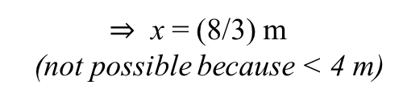
Find a Place for Zero Electrical Force 2 [2]
For these two charges, where could a third charge with q₃ > 0 be placed so that the net electrical force acting on it is zero?
x = x-coordinate of the new charge, d = distance between q1 and q2 = 4 m
r1 = distance between q1 and q3 = x, r2 = distance between q2 and q3 = x - d
y
d = 4 m
When net force = 0:
Force btwn q1 and q3 = Force btwn q2 and q3
q₁
q₂
q₂
x
Coulomb’s Law:
q₁ = +16 nC and is at the origin
q₂ = –4 nC and is at (4 m, 0 m)
r₁ = x
with +:
with –:
r₂ = x
x = 2 (x – d)
x = –2 (x – d)
d = 4 m
$⇒$ x = 8 m
$⇒$ x = (8/3) m
(not possible because < 4 m)
Something to think about: what if q3 had been a negative charge??

Slide 23
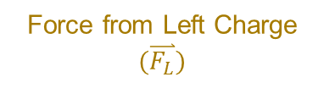
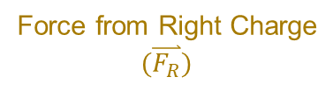
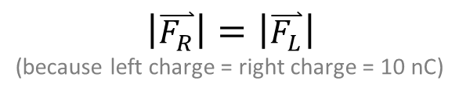
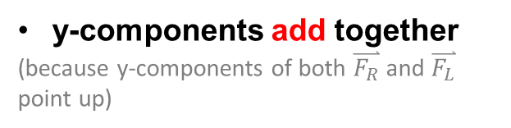
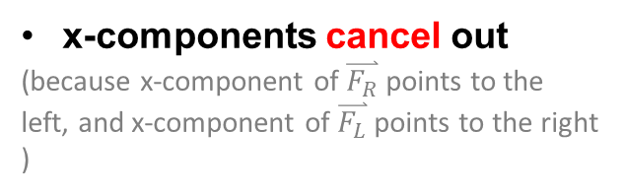
Using Coulomb’s Law in 2D
Three +10 nC charges are at the corners of an equilateral triangle with sides that are 5 m long. What is the net force on the top charge?
Force from Right Charge
$$(\overset{⃑}{F_{R}})$$
Force from Left Charge
$$(\overset{⃑}{F_{L}})$$
$\left|\overset{⃑}{F_{R}}\right|=\left|\overset{⃑}{F_{L}}\right|$
(because left charge = right charge = 10 nC)
y
x-components cancel out
(because x-component of $\overset{⃑}{F_{R}}$ points to the left, and x-component of $\overset{⃑}{F_{L}}$ points to the right )
y-components add together
(because y-components of both $\overset{⃑}{F_{R}}$ and $\overset{⃑}{F_{L}}$ point up)
x
Therefore: F_{net,x} = 0 ; F_{net,y} = F_{Ry} + F_{Ly}

Slide 24








Balancing a Charge (in 2D)
Three charges are at the corners of an equilateral triangle with sides that are
2 m long. The bottom two charges are each +500 nC, and they are being used to suspend the top charge (against its weight). If the top charge has a mass of 20 × 10^{–6} kg, what is its charge?
Force from 1
Newton’s 2nd Law:
Force from 2
$$60°$$
Acceleration of top charge is zero
(because it is at rest)
y
$$r$$
$$r$$
$\hat{x}$:
w = mg
$\hat{y}$:
$$60°$$
$$r$$
1
2
x
where:
Plugging into above equation for $\hat{y}$:

Slide 25
Finding Force on Charge
When finding the point where the net force was zero:
We do not need to know the sign of the third charge or its magnitude
All we needed was the location and magnitudes of the other charges
For 2D problem, if the top charge’s magnitude increased would the net force change direction?
No
If top charge’s sign changed, would the net force change direction?
Reverse
Knowing parts of system can give general idea of force on the rest.

Slide 26
Electric Fields
OpenStax Chapter 18.4
Electric Fields
  Measure contribution some charges make to electric force on another charge
  Point in the direction of the force they exert on a positive particle
  Point away from positive particles that create them
Every charge generates an electric field
  Force on one charge depends on other charge’s electric fields

Slide 27
Electric Field
(electric force per unit charge)
Electric fields give us a way to summarize how a group of charges will affect a new charge
Electrical charges change space near themselves generating electric fields
Electric field created by one group of charges exerts force on another charge
Electric Force acting on probe particle
Electric Field: Source charges’ contribution to force on other charge
E-Field created by source charges
SI Units: N / C
Charge of a probe particle

Slide 28
Notes About Electric Field
From Definition:
Electric field is in the same direction as the force it exerts on a positive charge
Electric field is in the same direction as the force it exerts on a positive charge
Electric field is in the opposite direction as the force it exerts on a negative charge
Electric field is in the opposite direction as the force it exerts on a negative charge
Reminder (near Earth):
g is strength of “gravitational field”
Charges in E-Fields behave like Masses in g-fields

Slide 29
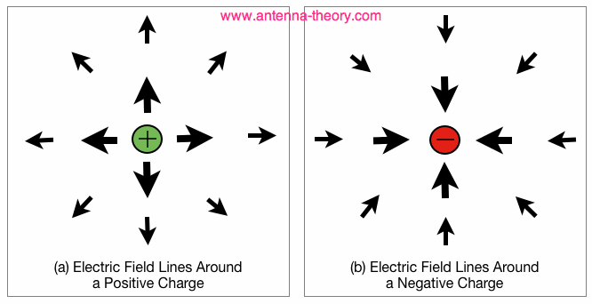
Electric Field Diagram
Collection of vectors showing magnitude and direction of electric field at different points
(arrows are called field lines [see slide 39])
Length of each arrow: strength of field at arrow’s start point
Close to charges, electric field is stronger

Slide 30
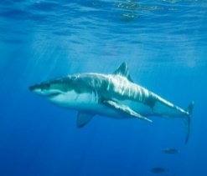

Places E-Fields Show Up
In nature
Technology
Start charged particles moving:
Atoms / Ions
10⁺¹¹ N/C
Electrical circuits
10^{–2} N/C
Muscle depolarization
CRT Monitors or TVs
Sharks can detect
10^{–7} N/C
Basis for EKGs
Electrophoresis
10⁺³ – 10⁺⁴ N/C

Slide 31
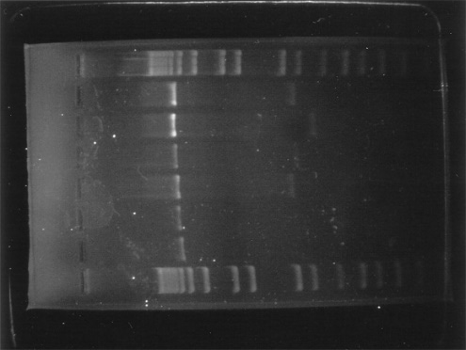
Electrophoresis
Put DNA pieces in uniform electric field
Here, fragments released from rest move left to right
What’s the sign of the charge on the fragments?
Electrophoresis Chamber
Force on particles is opposite direction of the field…
so particles must be negative
Fragments are sorted by how far they move in a given time
http://en.wikipedia.org/wiki/File:DNA_Agarose_Gel_Electrophor.jpg

Slide 32
Electrophoresis
Put DNA pieces in uniform electric field
Fragments are sorted by how far they move in a given time
Rank these particles by the order in which they cross the chamber (neglect drag):
3rd
3rd
A
B
1st
C
2nd
D
4th
E
mass
m₀
m₀/2
m₀/2
2m₀
2m₀
http://en.wikipedia.org/wiki/File:DNA_Agarose_Gel_Electrophor.jpg
charge
q₀
2q₀
q₀
q₀
2q₀
Kinematics:
Released from rest
Newton’s 2nd:
Electric Field:

Slide 33
Balancing Using an E-field
What e-field could be used to suspend an electron near the Earth’s surface (m_{e} = 9.11 × 10^{–31} kg)?
Which way does the electric force have to point?
5.58 × 10^{–11} N / C, up
5.58 × 10^{–11} N / C, down
1.43 × 10^{–48} N / C, up
1.43 × 10^{–48} N / C, down
2.69 × 10^{–7} N / C, up
Up (to balance weight)
Which way does the electric field have to point?
Down (since electrons are negative)

Slide 34
2D E-Field Problem
A charged block rests on a frictionless ramp in a region with a horizontally directed electric field as shown. If the ramp is tilted at 30° to the horizontal, the electric field’s magnitude is 500 N/C and the block’s mass is 3.0 mg, what is its charge?
a_{x} = a_{y} = 0 m/s²
F_{net;x} = F_{net;y} = 0 N
Free Body Diagram:
+34 nC
–34 nC
+59 nC
–59 nC
+56 nC
60°
30°
For Zero net force, electric force must be to left
Opposite electric field so particle is negative

Slide 35
2D E-Field Problem
A charged block rests on a frictionless ramp in a region with a horizontally directed electric field as shown. If the ramp is tilted at 30° to the horizontal, the electric field’s magnitude is 500 N/C and the block’s mass is 3.0 mg, what is its charge?
a_{x} = a_{y} = 0 m/s²
F_{net;x} = F_{net;y} = 0 N
Free Body Diagram:
+34 nC
–34 nC
+59 nC
–59 nC
+56 nC
In x direction:
In y direction:
F_{normal;x} – |F_{electric}| = m a_{x}=0
F_{normal;y} – |F_{g}| = m a_{y}=0
60°
F_{normal;x} = |F_{electric}|
F_{normal;y} = |F_{g}|
F_{normal} cos(60°) = |q|E
F_{normal} sin(60°) = mg

Slide 36
Field from Point Charge
Coulomb’s Law for force between two charges q and q':
The magnitude of the electric field generated by q is:
Direction of electric field created by source q:
Away from source q if q is positive
Towards source q if q is negative
Does not depend on probe q' at all

Slide 37
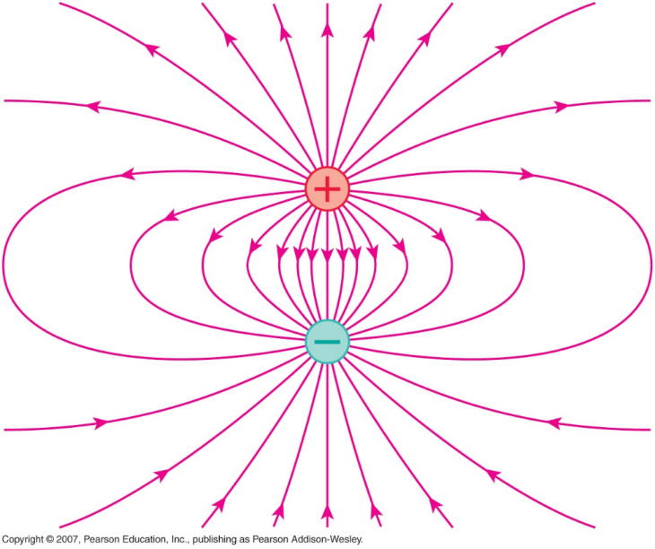
Field Lines
One way to represent electric fields is to draw “field lines”
Direction of lines: from positive to negative
Direction of field: tangent to field lines
Strength of field: stronger where lines are closer
Since lines are related to field (and so force) they cannot cross
Copyright © 2007, Pearson Education, Inc., publishing as Pearson Addison-Wesley

Slide 38
One Way to Look at Electric Field
“Source” charges create field
Field affects other charges
(the ones we’d study)
+ + + + + + + + + +
A
+1C
–1C
+2C
B
+1C
C
+1C
Field is Source’s Contribution to Force
Field is Force per Charge

Slide 39
Finding Field from Point Charge
The charge is +8 nC. What is the electric field at these points on rings with radii 6 mm and 12 mm?
For r = 6 mm:
q
For r = 12 mm:
Since radius is doubled, e-field is divided by four
E₁₂ = 0.5 × 10⁶ N/C = 5 × 10⁵ N/C

Slide 40

Superposition
When there are multiple charges, total electric field is the vector sum of all the present charges’ electric fields.
Rank the electric fields at the following locations which are equidistant from the left charge (the charges have equal magnitude, but the left is negative and the right is positive):
E-field from left is same size at all three
II
I
-
+
III
At I: field magnitudes subtract (will be smallest)
At II: field components add (will be less than III)
At III: field magnitudes add
So…
III > II > I

Slide 41
Superposition
When there are multiple charges, total electric field is the vector sum of all the present charges’ electric fields.
Rank the net electric field’s magnitude at the following locations (the charges have equal magnitudes but opposite signs):
Let:
–
+
I
II
III
IV
A. E_{I} = E_{III} > E_{IV} > E_{II}
B. E_{II} > E_{I} = E_{III} > E_{IV}
C. E_{III} = E_{IV} > E_{II} > E_{II}
D. E_{I} = E_{III} > E_{II} > E_{IV}
E. E_{I} = E_{III} > E_{II} = E_{IV}
I
II
III
IV

Slide 42
Charged Conductor I
(OpenStax Chapter 18.7)
Electrostatic Equilibrium: charges aren’t moving
Add excess electrons
Remove electrons
Conductor is negatively charged
Conductor is positively charged
Extra electrons will move to the surface (as far away from each other as possible)
If electrons move to the surface, they would be attracted to positive charge in material
In both cases electric field inside conductor is zero; external field is perpendicular to surface
Electrons arrange so positive charge is at surface

Slide 43
Dipole in Field
A dipole is a pair of connected charges which are equal in magnitude but opposite in sign
In this uniform field, what are the net force and torque (measured about center) on this dipole?
ϕ
+Q
Net Force: 0
torque = F r sin(ϕ)
–Q
L
Net Torque: Q E L sin(ϕ)
Net Torque is zero when:
ϕ = 0° or 180°
Dipole in electric field rotates until net torque = 0
(i.e. it is aligned in the same direction as the field)

Slide 44
Summary
Electric Fields
  Measure contribution some charges make to electric force on another charge
  Point in the direction of the force they exert on a positive particle
  Point away from positive particles that create them

