Slide 1
Chapter 12
Introduction to Human Geography (2018)
University of North Georgia Press
HUMAN SETTLEMENTs
Lecture Notes by Dorrell, Henderson, Lindley, & Connor.

Slide 2
Chapter 12: Human Settlements
STUDENT LEARNING OUTCOMES
By the end of this section, the student will be able to:
Understand the similarities and differences between rural and urban
Explain urban origins and how the earliest settlements developed independently in the various hearth areas
Describe the models of rural and urban structure, comparing and contrasting urban patterns in different regions of the world
Connect the nature and causes of the problems associated with overurbanization in developing countries
Introduction to Human Geography (2018). Dorrell, Henderson, Lindley, & Connor. University of North Georgia Press.

Slide 3
Chapter 12: Human Settlements
CHAPTER OUTLINE
12.1 Introduction
12.2 Rural Settlement Patterns
12.3 Urbanization
12.4 Urban Patterns
12.5 Conclusion
Introduction to Human Geography (2018). Dorrell, Henderson, Lindley, & Connor. University of North Georgia Press.

Slide 4
12.1 Introduction
Rural
Villages, agricultural areas, forests, various parks, wilderness, services, educational and research centers
Living space
Buffer zones between unpopulated wilderness zones and overloaded centers of dense development
Urban
Centers for consumer and business services
Today, over 55% of the world population (7,621 million) lives in urban areas (www.prb.org, 2018)
The proportion of the urban population is growing at a rapid rate
Urbanization
Factors:
Technological developments
Industrialization
Service-based economies
Global processes of economic, cultural, and political changes
MDCs (core) vs. LDCs(periphery):
Core regions: urbanization has largely resulted from economic growth
Peripheral regions: urbanization has been a consequence of demographic growth
Notes:
Source: https://genographic.nationalgeographic.com/human-journey/

Slide 5
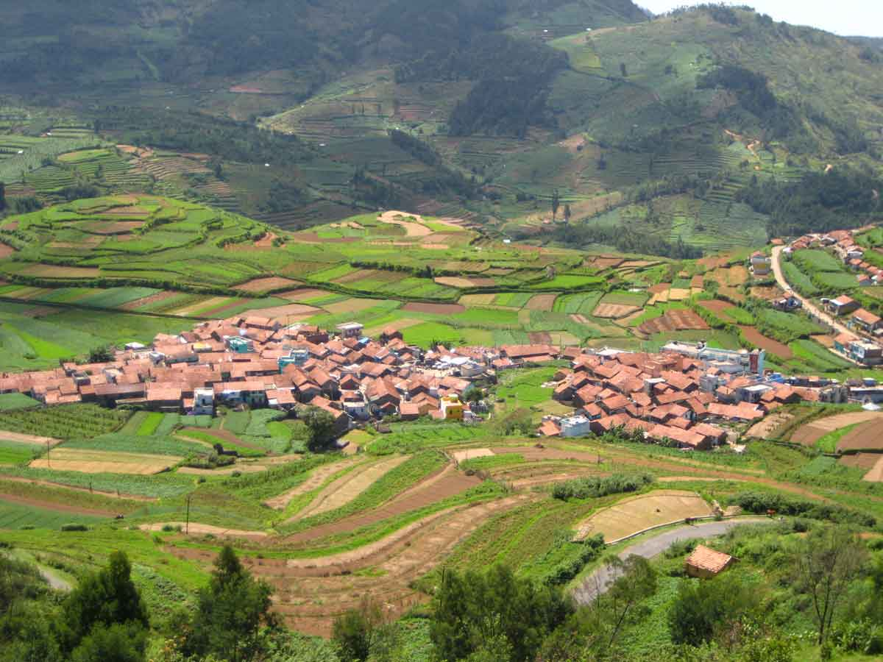
12.2.1 Clustered Rural Settlements
12.2 Rural Settlement Patterns
Families live in close proximity to each other
Fields surround the houses and farm buildings
Compact Rural Settlements
Location: - plain areas
- hilly
- mountainous depressions
Center: public buildings
Successive rings: - houses
- small gardens
- farmland
Figure 12.1 | A Compact Village in India
Notes:
Source: https://genographic.nationalgeographic.com/human-journey/

Slide 6
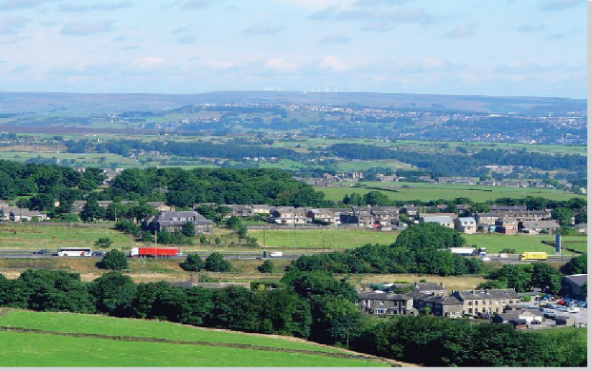
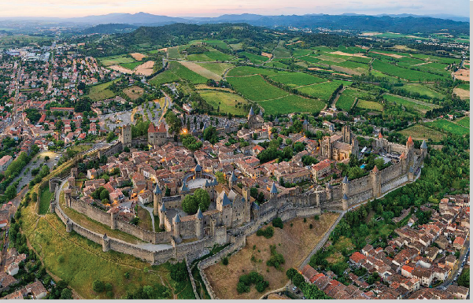
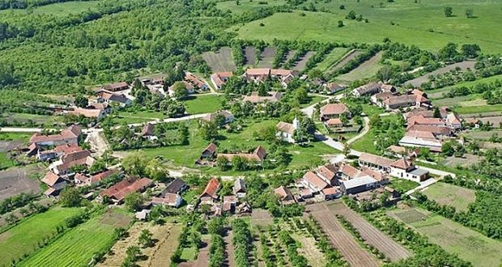
12.2.1 Clustered Rural Settlements (continued)
Linear Rural Settlements
Circular Rural Settlements
Buildings: along a road, river, dike, or seacoast
Agricultural land: behind the buildings
Figure 12.2 | Linear Village of Outlane
A central open space surrounded by structures
Europe: Medieval planned settlements, typically laid out on a grid pattern
Figure 12.3 | Bastide in France Figure 12.5 | Charlottenburg, Romania

Slide 7
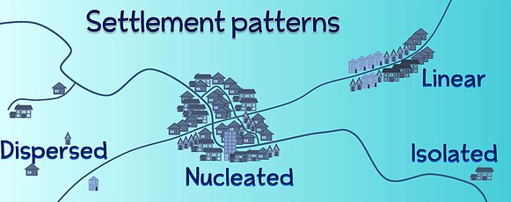
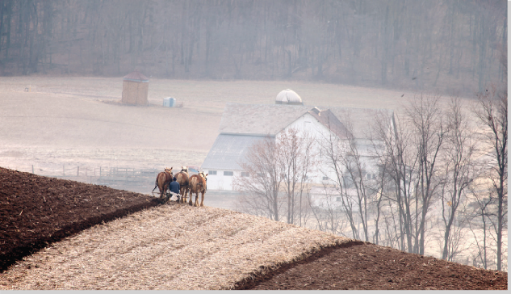
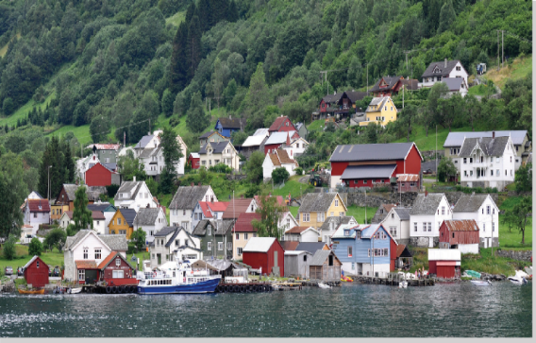
12.2.2 Dispersed Rural Settlements
Western Europe, North America
Scattered Rural Settlements
Highest elevations
Pastoral economic life, mining Figure 12.6 12.6 | Settlement Patterns
Isolated Rural Settlements
Separate farmsteads
U.S., Canada, Australia, Europe
Large plains and plateaus agricultural areas
Figure 12.7 | Isolated Horse Farm Figure 12.8 | Undredal, Norway

Slide 8
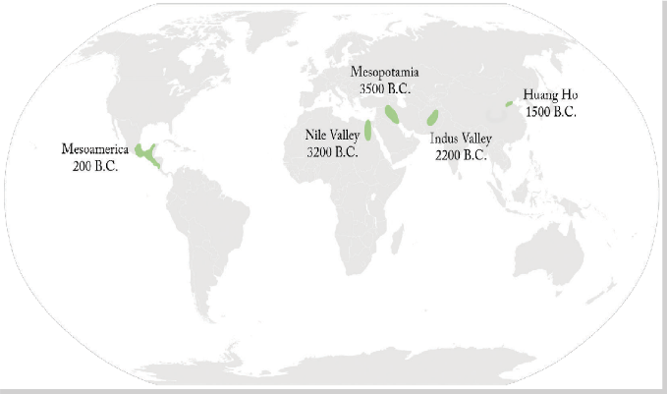
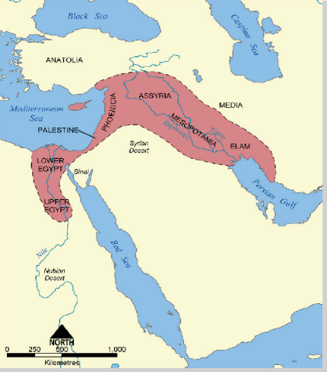
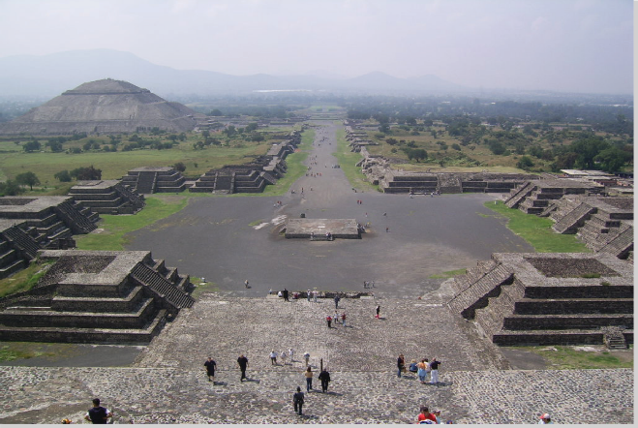
12.3.1 Urban Origins
12.3 Urbanization
Hearth Areas
The first agricultural revolution (from hunting/gathering to agriculture)
SW Asia: Mesopotamia, Tigris & Euphrates Valleys (Iraq)
- Fortified city-states: Ur, Uruk, Eridu, Erbil, Babylon (3500B.C./ Fertile Crescent )
Egypt: Nile Valley -- no fortifications/Memphis, Thebes
India-Pakistan (2500 B.C./Indus Valley-- Mohenjo-Daro) Figure 12.9 | Five Hearths of Urbanization
Northern China (1800 B.C./Huang He Valley)
Mesoamerica (100 B.C./Teotihuacan)
Andean America (800 A.D.)
Figure 12.10 | Fertile Crescent Figure 12.11 | Teotihuacan, Mexico
Notes:
Source: https://genographic.nationalgeographic.com/human-journey/

Slide 9
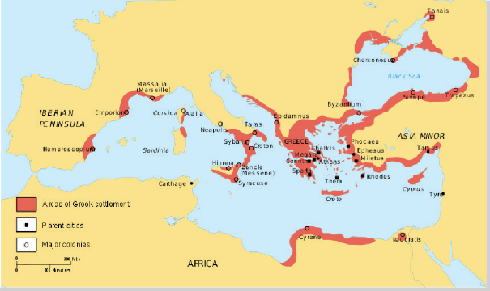
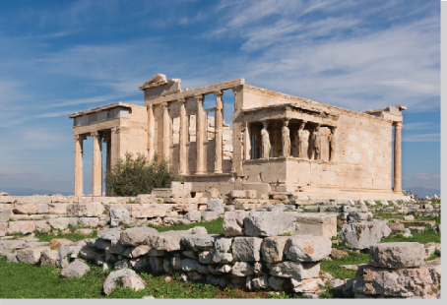
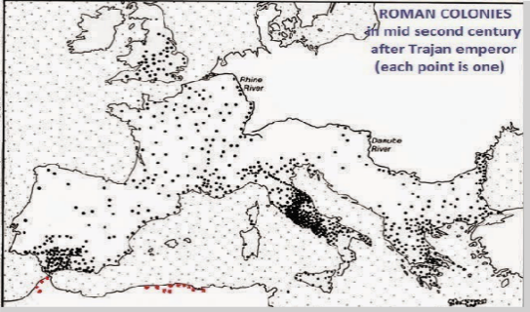
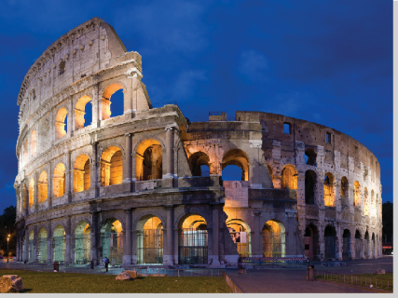
Europe Extensive & Sophisticated Urban Systems
Greece
Roman Empire
Cities (by 800 B.C.): Athens (150,000 inhabitants)
Sparta, and Corinth (independent)
Colonization: From West/Spain to East/Black Sea
Figure 12.12 | Athens, Greece, Acropolis
Figure 12.13 | Greek city-states in the Mediterranean
4th century B.C.: Macedonians conquered Greece
Alexander the Great extended the Greek urban system eastward toward Central Asia
Long-distance sea trade
The Romans:
Well integrated urban system: From England to Babylon
Centered on Rome (100 A.D. = 1,000,000 inhabitants)
Towns: - not independent; very sophisticated
- System of roads, grid system, city walls
- Paved streets, piped water, sewage systems
- Massive monuments, grand public buildings
The 5th century: Rome declined
Laid the foundation for the Western European urban system
Figure 12.14 | Roman Empire and its Colonies
Figure 12.15 | Colosseum in Rome, Italy

Slide 10
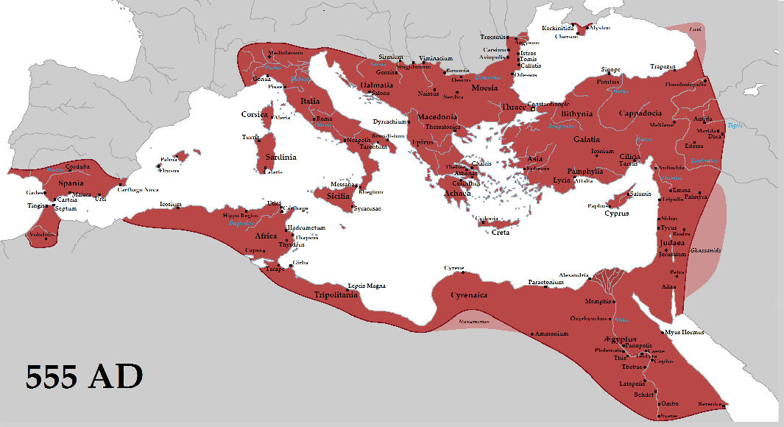
12.3.2 Dark Ages
Early medieval period, A.D. 476-1000 (kingdoms and estates)
Western Europe - A decline in urbanization (wars, epidemics, barbarian migrants)
- Feudalism: rurally oriented, rigid
Emperor: Constantine the Great
Roman Empire/Capital: Byzantium, Constantinople (current Istanbul, Turkey)
Constantinople - the world’s largest city (strategic location for trade)
A few small (specialized) towns:
University centers: Cambridge (England), St. Andrew (Scotland)
Ecclesiastical: Chartres (France), Liege (Belgium)
Defensive strongholds: Urbino (Italy), Rasnov (Romania)
Administrative centers: Cologne (Germany), Falkland (Scotland)
Gateway towns: Bellinzona (Switzerland)
Figure 12.16 | Byzantine Empire

Slide 11
12.3.3 Urban Revival in Europe
Late Medieval Europe:
11th Century:
A new phase of urbanization
merchant capitalism: A money economy and trade
Paris (275,000 people): dominant European city
Larger cities: Constantinople, Cordoba, Milan, Florence, Bruges
14th and 18th centuries:
Protestant Reformation
Scientific Revolution
Renaissance
Colonization
Stimulated world economic and social reorganization; national states
Europeans: leaders & shapers of the world’s economies & societies
Colonization
Spanish and Portuguese colonists: the first to extend the European urban system to the world’s peripheral regions
Between 1520 and 1580: Spanish colonists established the basis of a Latin American urban system

Slide 12
12.3.4 Industrial Revolution and Urbanization
Industrial Revolution-England (18th century): /Accelerated further urbanization
First half of the 19th century: Industrialization/the rest of Europe
Second half of the 19th & the 20th centuries: Industrialization/ different parts of the world
Factors: canals (Suez/1860; Erie/1825), railroads, & steam-powered transportation
Shock cities: Surprising and disturbing changes in economic, social, and cultural life in a short period of time
Manchester: 1750/15,000 inhabitants; 1911/2.3 million
Chicago: 1837/4,200 inhabitants; 1930/3.3 million
Manchester & Chicago: industrial world cities & key nodes in the world economy
19th-20th Centuries: Urbanization– Important dimension of the World System
Cities: pull factors, rural-urban migration
World Urban Population: 3%/1800; 55%/2018 (www.prb.org)
* MDCs/79%; LDCs/50% (www.prb.org/2018)

Slide 13
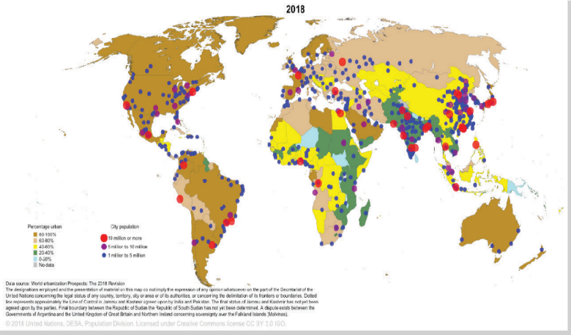
12.3.5 City-Size Distribution
Most developed countries have a higher percentage of urban people
(MDCs:79%; LDCs: 50; Australia: 86%; Americas: 80%; Europe: 74%; Africa:43%; Asia: 49%); www.prb.org, 2018
Developing countries have more of the very large urban settlements
- 1950: 18/MDC & 12/LDC; 2000: 22/LDC; 2010: 24/LDC; 2020: 25/LDC; 2035: 4/MDC & 26/LDC
- LDC/1950: 3/> 5 mill; 2020: 7/>20 mill & 1/>30 mill (Delhi); 2035: 10/>20mill, 2/>30 mill, & 1/> 40mill (Delhi)
Source: The 30 Largest Urban Agglomerations Ranked by Population Size at Each Point in Time, 1950-2035. WUP2018-F11a-30_Largest_Cities_xls
Rank-size rule: A regular pattern (the second-largest city is one-half the size of the largest)
2020: New York-Newark/19 mill; Los Angeles-Long Beach-Santa Ana/12 mill
Primate cities: The largest city is disproportionately large in relation to the second
Argentina: Buenos Aires is 10 times larger than Rosario, the second largest city
Centrality: The functional dominance of the city
World cities: Play key roles beyond their own national boundaries
London, New York, Tokyo
Figure 12.17 | Percentage Urban and Urban Agglomerations

Slide 14
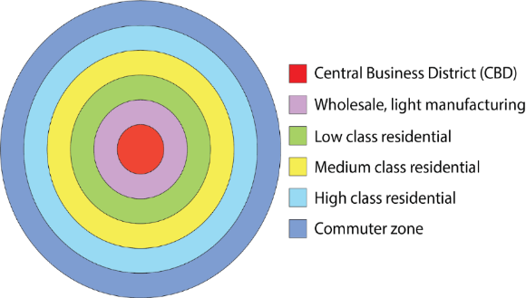
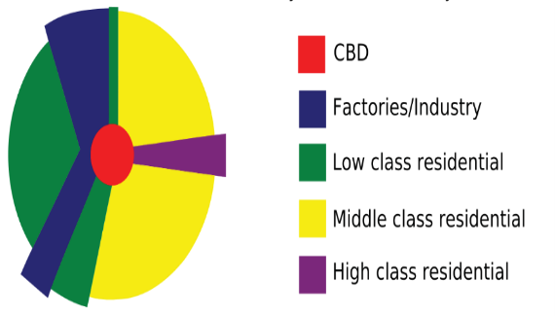
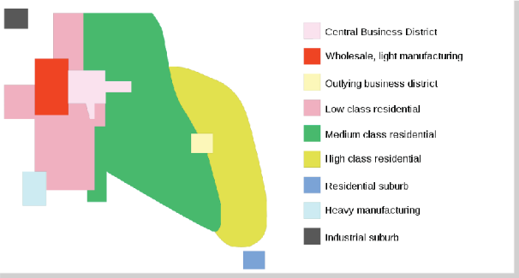
12.4.1 North American Cities
12.4 Urban Patterns
Central Business District (CBD):
a city’s nucleus of commercial and services land uses (“downtown”)
one of the oldest districts of the city
most visually distinctive area
densest concentration of shops, offices
tallest nonresidential buildings
nodal point of transportation routes
Ledge cities: New suburban growth
Figure 12.19 | Concentric-Ring Theory
Land-use Patterns
Concentric zone model
Sector
Multiple nuclei
Figure 12.20 | Sector Theory Figure 12.21 | Multiple-Nuclei Theory
Notes:
Source: https://genographic.nationalgeographic.com/human-journey/

Slide 15
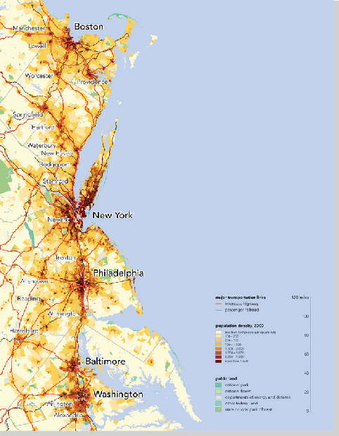
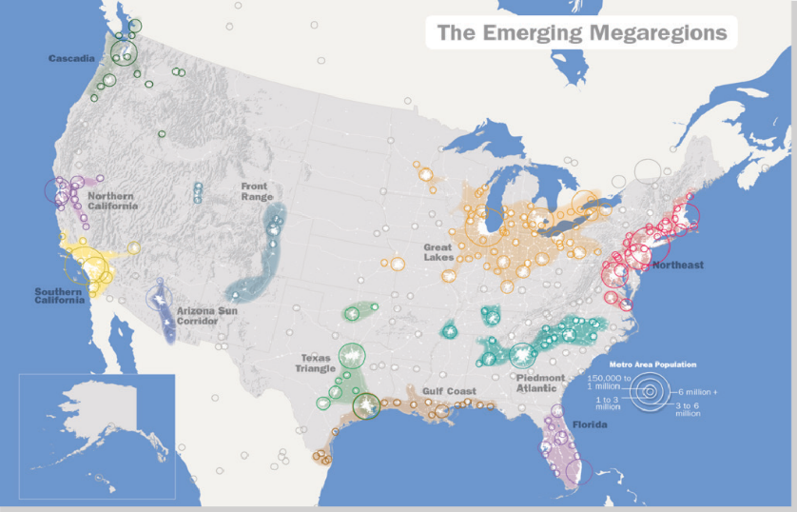
12.4.1 North American Cities (continued)
Megalopolises: Urban agglomerations
Boston-Washington Corridor (BosWash)
50 million inhabitants; 400 people/sq. km
15% of the U.S. population
most urbanized U.S. region
2% of the nation's land area
20% of the U.S. GDP
Inner city challenges
fiscal squeeze, poverty, homelessness
neighborhood decay, infrastructure
Gentrification
Renovated inner cities Figure 12.22 | Map of Emerging US Megaregions Figure 12.23 | Megalopolis BosWash

Slide 16
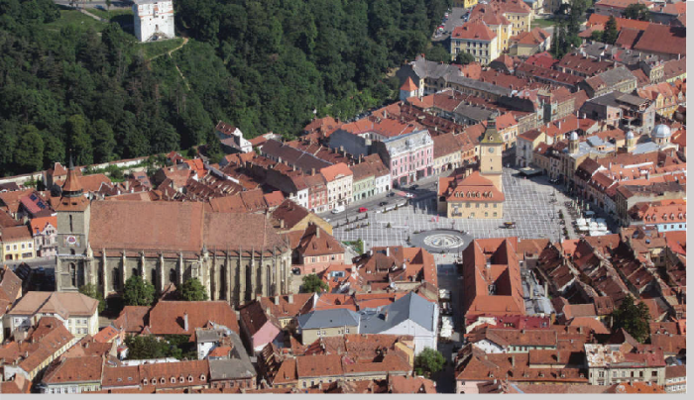
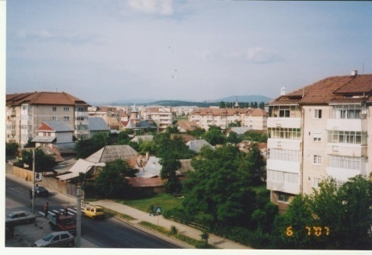
12.4.2 European Cities
Characteristics
Europe: High level of urbanization (>80% = N & W)
Long history (> 2000 y. o.): Greek & Roman Empires
Product of several major epochs of urban development
Largest metropolitan areas: Paris (11 mill), London (11 mill), & Madrid (6 mill)
Variations W-E & N-S: W & N/Germanic, S/Mediterranean, E/former communist
Land-use Patterns
Concentric, Sector, & Multiple nuclei (similar to the U.S.) Figure 12.24 | Braşov, Romania: CBD square and city hall
Spatial Distribution
CBD - more residents, less business services
- very expensive, higher-income people
- preservation of the historical areas
- palaces, cathedrals, symbolism
Outer ring -- poor people
Figure 12.25 | Onesti, Romania: Urban-rural interaction

Slide 17
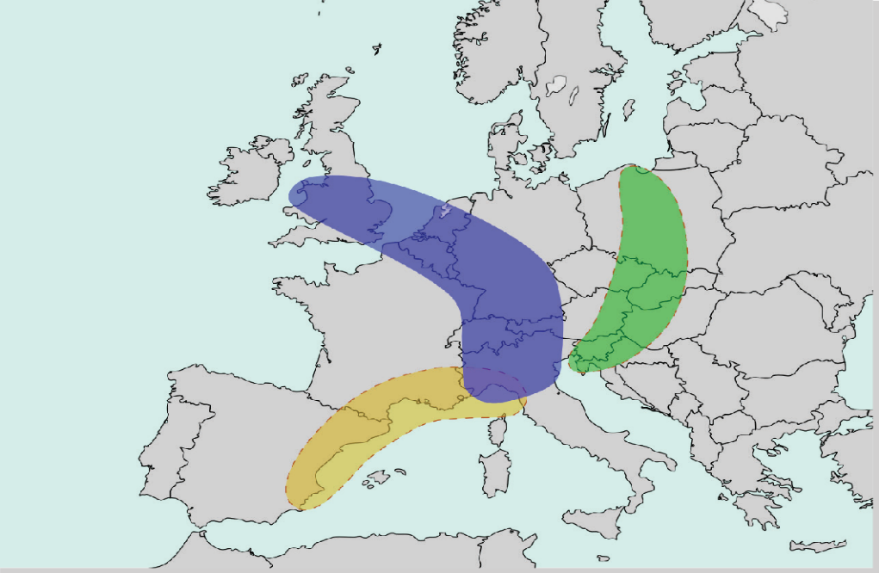
12.4.2 European Cities (continued)
Megalopolises
Blue Banana: Manchester-Milan Axis
- 111 million inhabitants
- From NW England-London to Northern Italy
Golden Banana
(European Sunbelt / Mediterranean Coast)
Scandinavian Megalopolis
(Oslo-Copenhagen Corridor) Figure 12.26 | The Bananas of Europe

Slide 18
12.4.3 Sustainable Cities vs. Suburban Sprawl
Suburban Sprawl
Sustainable Cities
Annexations: Legally adding land area to a city from surrounding counties
Sprawl: Development of new housing sites at relatively low density population
- North America - endemic
- Europe - less common
Characteristics:
low density, single-family
automobile dependence, commuting time, cost of gasoline
air pollution, health problems
lost agricultural land, financial government issues
Smart growth (compact city): Urban planning that concentrates growth in compact areas
Characteristics:
higher density of living spaces
preserve open space, farmland, and resources
a variety of transportation choices
predictable, fair, and cost-effective development
costs and benefits equitably distributed
community collaboration in developing decisions
values long-range, regional considerations of sustainability

Slide 19
12.5 Conclusion
Rural
Comes into existence in certain areas
Land use: especially for agriculture & forestry
Low population density, small settlements, & an agrarian way of life
Includes also non-agricultural activities
Rural population: 45% of the world’s population (www.prb.org, 2018)
There are many types of rural settlements
Rural settlements of a region reveal its culture, history & traditions
Urban
Large numbers of people live and work
Hubs of government, commerce, and transportation
City proper: a city according to an administrative boundary
Urban agglomeration: considers the extent of the built-up area
Metropolitan area: boundaries are defined according to the degree of economic and social interconnectedness of nearby areas
Urban population: 55% of the world’s population (www.prb.org, 2018)
Urban population by continent: Americas/80%, Europe/74%, Oceania/67%, Asia/49%, Africa/43% (www.prb.org, 2018)
Notes:
Source: https://genographic.nationalgeographic.com/human-journey/

Slide 20
12.X Documentary Film List for Human Settlements
Green Towns (2008).
https://ggc.kanopy.com/video/green-towns-usa-new-deal
Urbanized (2011).
https://ggc.kanopy.com/video/urbanized-2
Great Cities: Rise of the Megalopolis (2007).
https://fod-infobase- com.libproxyb.ggc.edu/p_ViewVideo.aspx?xtid=40204&loid= 65033&tScript=0
Cradle Of Western Civilization (Greece) (2002).
https://ggc.fod-infobase-com.libproxyb.ggc.edu/p_ ViewVideo.aspx?xtid= =76952&loid= 331576&tScript=0
Mohenjo-daro (2000).
https://fod-infobase-com.libproxyb.ggc.edu/p_ViewVideo.aspx?xtid=11655&loid= 7898&tScript=0
Charlottenburg, a round shaped village (Timiș County, Romania) (2013).
https://www.youtube.com/watch?v= GWB4Q3NQ96M
Shakaland Zulu village, South Africa (2013).
https://www.youtube.com/watch?v=AcYS0u--adk
Shenzhen: The Silicon Valley of Hardware:
https://www.youtube.com/watch?v=SGJ5cZnoodY&t=1s
Holy Land: Startup Nations:
https://www.youtube.com/watch?v=I5h8GfxIWVY

Slide 21
Chapter 12 END
Introduction to Human Geography (2018)
University of North Georgia Press
HUMAN SETTLEMENTS
Lecture Notes by Dorrell, Henderson, Lindley, & Connor.

