Slide 1
Sensors

Slide 2
Sensors
Devices that measure a physical quantities, like temperature, humidity, stress, etc.
Convert such non-electrical data into electrical signals
Output
1) Output signal generally is analog voltage proportional to the property being measured
2) Some provide digital output signal about the property
Typically, sensor output is sent as input to a microcontroller

Slide 3
Sensor types
Notes:
Practical Electronics for Inventors by Schertz

Slide 4
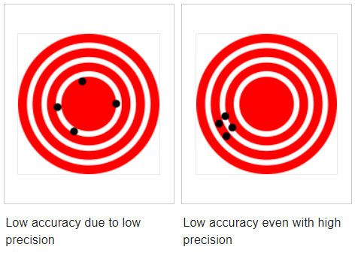
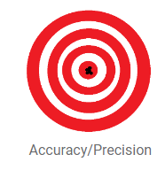
Precision, Accuracy, and Resolution of Sensors
Precision is how close the measurements are to each other
Accuracy is how close a given set of measurements are to the true value
Resolution of a sensor is its smallest measured value
Notes:
https://en.wikipedia.org/wiki/Accuracy_and_precision

Slide 5
Sensor Calibration
No sensor is perfect.
- They have manufacturing variations
- Sensor material’s are subject to variations in performance due to variations in external parameters such as heat, shock, humidity, etc.
Calibration: is an adjustment that is performed on a sensor to make it function as accurately as possible
Reasonably accurate physical standards can be used for calibration. For example
- rulers, meter sticks
- boiling water, 100 C at sea level
- ice-water bath

Slide 6
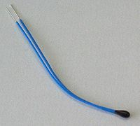
Temperature Sensors: Thermistor
Thermistor: is a type of resistor whose resistance depends on its temperature
In approximation, the relationship between resistance and temperature is linear
$$∆R:change in resistance$$
$$∆T:change in temperature$$
$$k:temperature coefficient of resistance \left(constant\right)$$
If k is positive, the resistance increases with increasing temperature
If k is negative, the resistance decreases with increasing temperature
Used in temperature range –40 to +125°C
Notes:
https://en.wikipedia.org/wiki/Thermistor

Slide 7
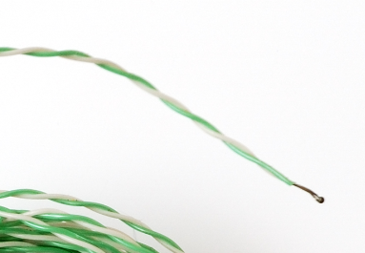
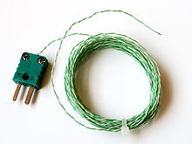
Temperature Sensors: Thermocouple
Two different metals are joined, the temperature of the junction can be measured by measuring the voltage across the metal leads, at the far end from the junction
It produces a temperature-dependent voltage across its terminals
The measured voltage can be interpreted to measure the sensed temperature
Its limitation is poor accuracy
Useful for sensing higher temperatures (>125 C)
The wires that make up the thermocouple must be insulated from each other everywhere, except at the sensing junction
Notes:
https://en.wikipedia.org/wiki/Thermocouple

Slide 8
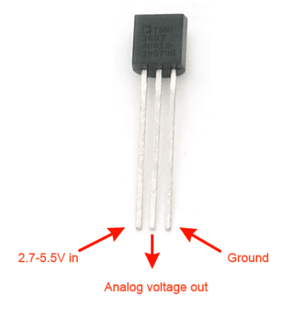
Temperature Sensors: Resistance Temperature Detectors (RTD)
consist of a length of fine wire wrapped around a heat-resistant ceramic or glass core
Used material has an accurate resistance-temperature relationship which is used to provide the value of sensed temperature
Notes:
https://en.wikipedia.org/wiki/Resistance_thermometer
https://learn.adafruit.com/tmp36-temperature-sensor

Slide 9
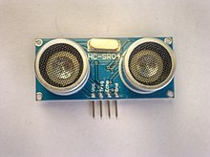
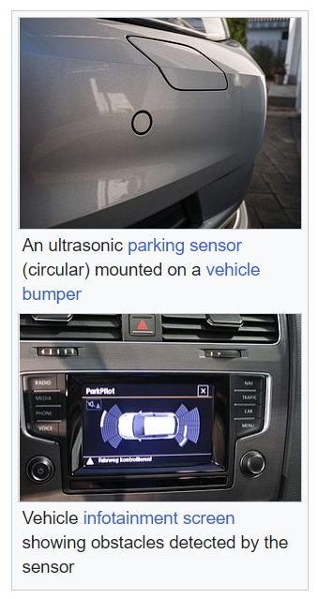
Ultrasonic Distance Sensor
It sends out a pulse of ultrasound and times how long it takes for the reflection to come back
Calculation involving the speed of sound determines the sensor’s distance to the object
Total distance travelled by sound waves for round trip
round-trip distance = velocity × time
Distance between sensor and object = round-trip distance / 2.0
Notes:
https://en.wikipedia.org/wiki/Ultrasonic_transducer

Slide 10
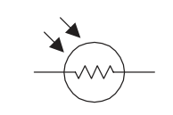
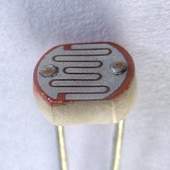
Photoresistor (LDR- Light Dependent Resistor)
Photoresistors are light- controlled variable resistors
It has very resistance (about million of Ohms) when placed in the dark
When it is illuminated, its resistance decreases significantly (to a few hundred ohms)
If incident light on a photoresistor exceeds a certain frequency,
- light photons are absorbed by the semiconductor material
- this results in giving bound electrons enough energy to jump and become unbound
- the resulting free electrons conduct electricity
- thereby lowering resistance of LDR
Notes:
https://en.wikipedia.org/wiki/Photoresistor

Slide 11
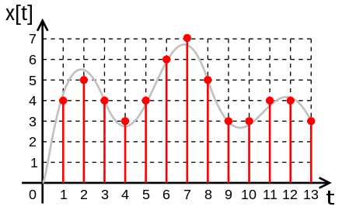
Analog-to-Digital Converter
An electronic device that converts an analog signal to digital signal
Analog signal:
is any continuous signal representing a measurable quantity
Digital signal:
is an approximation of the original time-varying analog signal. It is obtained by sampling from analog signal
The red digital signal is the sampled and digitized values of gray analog signal.
A digital signal consists of a sequence of samples, which in this case are integers: 4, 5, 4, 3, 4, 6...
Notes:
https://en.wikipedia.org/wiki/Digital_signal_(signal_processing)

Slide 12
Basics of Digital Electronics
Only two voltage states present at any point in a circuit
These voltage states are either high voltage (+2.4 to +5 V) or low voltage (+0.8 to 0 V)
In Positive True Logic (PTL) means High Voltage = True
In Negative True Logic (NTL) means High Voltage = False
Notes:
Pg. 171, Practical Electronics For Inventors by Scherz

Slide 13
Binary Number System
A binary number is composed of two binary digits, 0 and 1
Voltage states of 0 and 1 are called bits (0 = low voltage and 1 = high voltage)
Decimal Number System

Slide 14
MSB and LSB
In a binary number,
Leftmost bit (aka highest-order bit) is called the Most Significant Bit (MSB)
Rightmost bit (aka lowest-order bit) is called the Least Significant Bit (LSB)

Slide 15
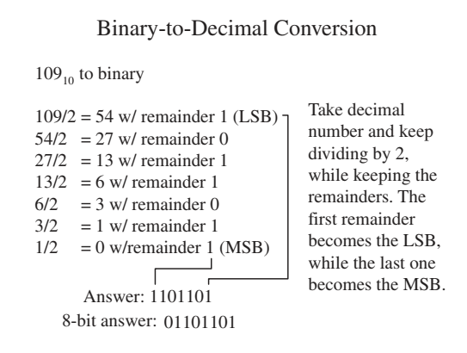
Binary to Decimal Conversion
Notes:
Pg. 719, Practical Electronics For Inventors by Scherz

Slide 16
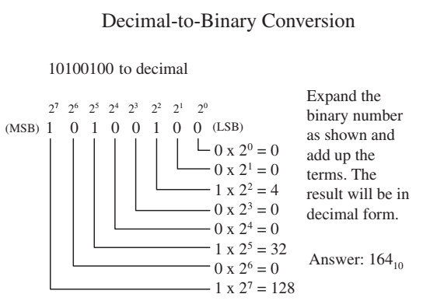
Decimal to Binary Conversion
Notes:
Pg. 719, Practical Electronics For Inventors by Scherz

Slide 17
Example Problems
Q1) Convert 17 (decimal number) into a binary number. (answer: 10001 in binary)
Q2) Convert 160 (decimal number) into a binary number. (answer: 10100000 in binary)
Q3) Convert 10100011 (binary number) into a binary number. (answer: 163 in decimal)
Q4) Convert 11101111 (binary number) into a binary number. (answer: 239 in decimal)

Slide 18
Internal Clock of Digital Equipment
Is an electronic oscillator that produces a clock signal for use in synchronizing all functions in a digital circuit
It produces an output of 0,1,0,1,… alternating log and high voltage signals and broadcasts it to all the digital components connected in the circuit
The output of a internal clock is a square wave
Clock Frequency: Refers to the frequency at which the clock generator of a processor can generates high-log-high pulses
The speed of the processor’s internal clock is used to synchronize the operations of all digital components connected to it

Slide 19
Analog-to-Digital Conversion
An ADC device that converts an analog signal into a series of binary numbers
Output generated by ADC is sent into a microprocessor or microcontroller, where they get processed, stored, interpreted for functional use

Slide 20
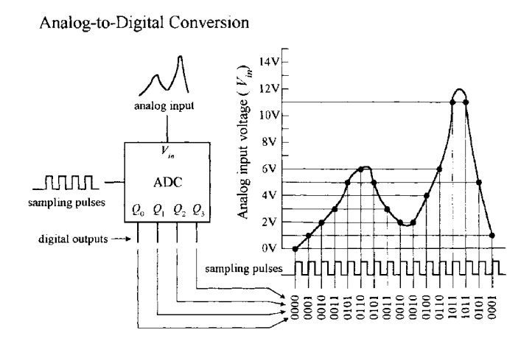
Analog-to-Digital Conversion
ADC receives an analog input signal along with a series of digital sampling pulses called clock signal
Each time a sampling pulse is received, the ADC measures the analog input voltage and outputs a 4-bit binary number that is equivalent to the input analog voltage
With 4 bits, we get 16 binary codes (0000 to 1111) that correspond to 16 possible analog levels (for example, 0 to 15 V)
Notes:
Pg. 804, Practical Electronics For Inventors by Scherz

Slide 21
Digital-to-Analog Conversion (DAC)
A DAC takes a binary number and converts it to an analog voltage
By inputting varying binary numbers, one after the other, a complete analog waveform is output by the DAC

Slide 22
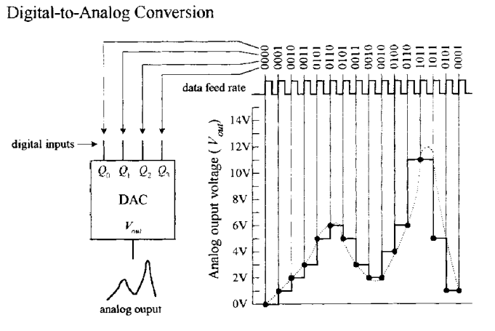
Digital-to-Analog Conversion (DAC)
DAC’s input is a series of 4-bit binary numbers
For each input binary number, a corresponding analog voltage is output
As with the ADC example, for a total of 16 binary numbers (0000 to 1111) there are 16 possible output analog voltages

