Slide 1
Chapter-01, Physics, and Technology in Robotics

Slide 2
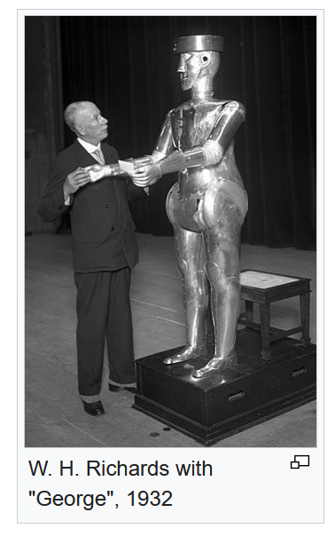
Physics and Robots
Word robot was coined by Czech playwright, novelist and journalist named Karel Čapek (1880-1938) who introduced it in his 1920 play, R.U.R., or Rossum’s Universal Robots
Robot is derived from Slavonic word Robota, that refers for “servitude,” “forced labor” or “drudgery”
In the US, robots became popular from works of science fiction writers, Isaac Asimov
Eventually became popular in Hollywood
First humanoid robot (Eric) was released in 1923
Physics is a natural science that studies matter
- its fundamental constituents
- its motion through space and time
- the related quantities of energy and force
Notes:
https://www.sciencefriday.com/segments/the-origin-of-the-word-robot/
https://en.wikipedia.org/wiki/Robot#Early_robots

Slide 3
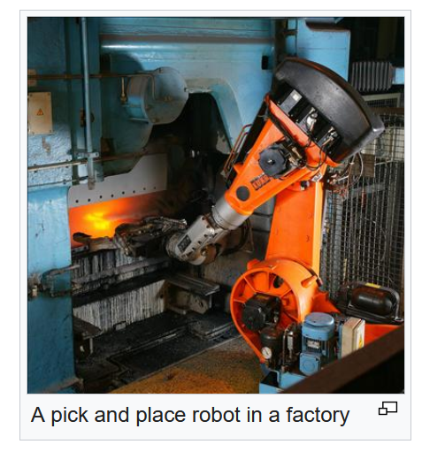
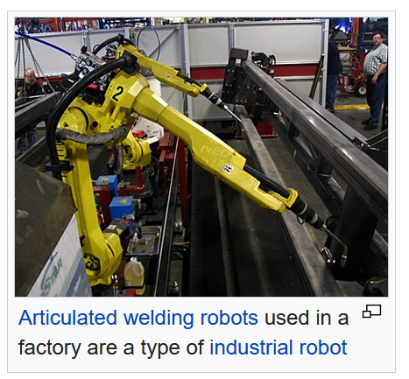
Types of robots
Industrial robots
- car production
- packaging
- electronics circuit board production
Telebots
Healthcare
Educational (interactive) robots
Notes:
https://en.wikipedia.org/wiki/Robot

Slide 4
Definition Robot
A reprogrammable multi-functional manipulator designed to move materials, parts, tools or specialized devices through various programmed motions for the performance of a variety of tasks
Robot Institute of America, 1979
Some of the branches of physics useful in robotics
Physics of motion: kinematics
Physics of the causes of motion: Dynamics
Physics of light: optics
Physics of electrical components: electricity
Physics of programmable circuits: digital electronics

Slide 5
Branches of physics relevant to robotics
Kinematics: the branch of physics concerned with the motion of objects without reference to the forces which cause the motion
Dynamics: concerned with the motion of objects in relation to the physical factors that cause and affect their motion: force, mass, momentum, and energy
Optics: is the branch of physics concerned with the
- origin and movement of light
- the changes that light experiences
- how light interacts with its environment
Electricity: deals with natural phenomenon associated with stationary and moving electric charges
Electronics: attempts to explain the ways of manipulating electric charges (electrons, ions etc.) using man-made devices

Slide 6
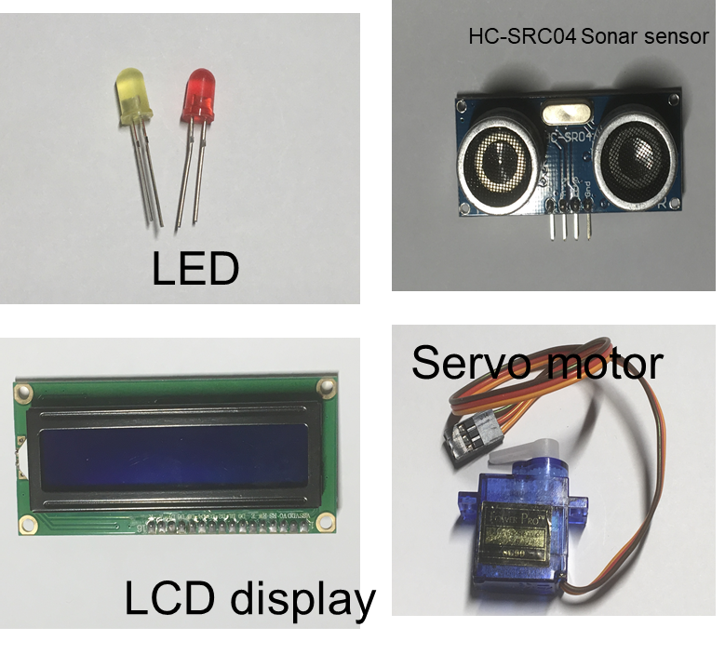
Technology
Application of scientific knowledge to reach practical goals in a custom and reproducible way
“The human process of applying knowledge to satisfy our needs and wants and to extend our capabilities” Hutchinson, 1994, p.4
Technology may also mean the product of such an application
Technologies include physical objects like utensils or machines and intangible tools such as software
Examples of Technologies
LED: Light Emitting Diode
Display systems: LCD (Liquid Crystal Display), OLED
Sensors: Sonar sensor, Temperature sensor, and so on
Motors: AC motor, DC motor, servo motor, stepper motor

Slide 7
Inter-relationships between science, technology and robotics
Scientific knowledge serves as source of ideas for developing new tools and techniques
Development of new tools and techniques accelerate growth of new/efficient
- engineering design
- research instrumentation
- laboratory techniques
- technologies
Development of new technology and tools enable us to push the boundary of knowledge by making new discoveries/better understanding of nature
The newly accessible knowledge (research) becomes a source for development of new human skills and capabilities
The new knowledge also helps in assessment of existing technology and pushes boundary of technology
Newly scientific knowledge New technology
pushes the boundary of
Notes:
https://www.belfercenter.org/publication/relationship-between-science-and-technology

Slide 8
Technological Literacy
Ability to use technology ideas and products to make informed decisions about (contemporary) technological advances
Can be summarized as
1) Being aware and having general understanding
2) Bing able to make informed decisions about technological advances

Slide 9
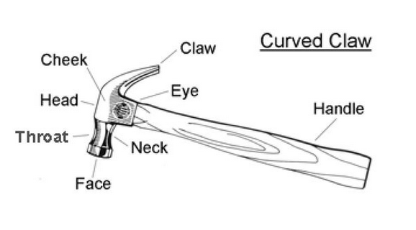
Hammer: Simple Example of Technology
Historical invention
- early human used its predecessor “rock”
- evidence of having a rock tied to wood around 4 BC
- evolved during stone age, bronze age, iron age and modern age
Evolution
- knowledge of using strings in tying things
- knowledge of using small and large sticks
- adding knowledge of shaping wood to make a handle
- adding knowledge of shaping rocks to make effective hammer head
- knowledge of using iron to make hammer head
- improving iron’s properties for hammer head application
- knowledge of improving metal’s properties, creating steel
- knowledge of heat treating process to improve versatility of hammer head metal
- knowledge of properties of materials to make handles (steel, fiberglass, etc.)

Slide 10
Homework
Choose a piece of technology (tangible or intangible)
Research
- when it was first invented/developed
- list out all the knowledge that led to its development
- list out any other technology (tangible or intangible) that were needed to refine your chosen technology
- what science concepts are needed in developing it to its current state of use
- Are there any other technologies that became a reality due to your chosen technology
- Were there any scientific discoveries that may have been helped by your chosen technology?

Slide 11
Components of a robots
Power unit
Convert AC to DC
Provide DC voltage to the motherboard, adapters, and peripheral devices
Provide cooling and facilitate air flow through the case
Manipulator/Rover
Main body of a robot (links, joints, and structural elements that move)
Gives the ability to move, pitch, roll, or spin robot’s part for appropriate application
Have the ability to reach in to tight/hazardous work spaces

Slide 12
Components of a robots
Actuators
A device which causes something to happen. This could be a robot movement, which is often achieved using motors
An actuator is needed to make the robots wheels turn. Or the joints of a robot arm to rotate.
Muscles of the manipulators (servo motors, stepper motors, pneumatic and hydraulic cylinders)
produces a motion by converting energy and signals in the robot
Sensors
Devices used to collect information about internal (of robot) and external (to robot)
Useful in communication with environment and getting information from environment
Pass electronic signals to robots for executing desired tasks
Robots need suitable sensors that help them control themselves

Slide 13
Components of a robots
Controller
Performs the logical role of brain
Helps in performing the intended role of the robot
Controls and coordinates the motion of actuators
Processes data from sensors
Controls the rover for robot’s motion
Performs maintenance related work, report errors in devices, etc.
Processor/Microcontroller
Performs the role of brain
Does calculations using data from sensors, actuators, etc and feeds it to controller
Exchanges data from and to controller

Slide 14
Components of a robots
Software
The host of programs understood by microcontroller
Required to make the robot “live”
Memory
Stores the operating system
Programmable instructions of the user
Error reporting data
Can be temporary memory (memory is lost after power is loss, similar to RAM in a PC)
Can be permanent memory (memory is retained after power loss also, similar to hard disk in a PC)

Slide 15
Power Unit
To obtain mechanical power out, it is essential to have power in
Amount of mechanical power out can be defined by the load or force to be moved
An important consideration while designing a robot is its power requirement and its maximum power output

Slide 16
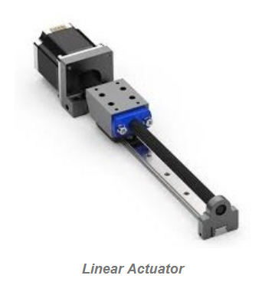
Actuators
Provide motion to the robot
Can act as
Legs
Wheels
Arms
Provide grip for holding other objects
Help in maintaining robots intended orientation
Physically interact with surroundings
Linear Actuators
Linear actuators in robotics are used to push or pull the robot like move forward or backward & arm extension
Notes:
https://www.elprocus.com/robot-actuator/

Slide 17
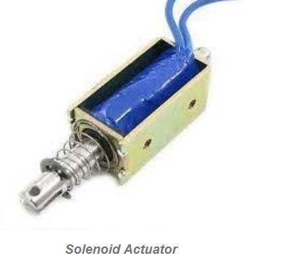
Actuators
Solenoid Actuators
A type of linear actuators that uses a solenoid latch that works on electromagnetic principles. Used in
controlling the motion of the robot
performing different activities such as a start & reverse, latch, push button, etc.
solenoids are normally used in the applications of latches, valves, locks, and pushing buttons
its working is controlled normally by an external microcontroller
Notes:
https://www.elprocus.com/robot-actuator/

Slide 18
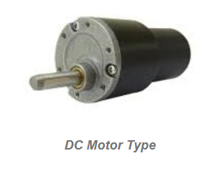
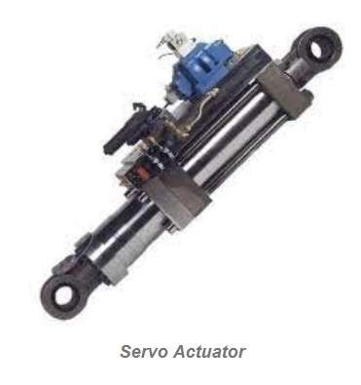
Actuators
DC Motor Actuators
Used for turning motion. It can be utilized for changing speed throughout rotating motions. By using these actuators, different activities like robotic drilling & robotic rotational motion are performed
Servo Actuators
Mainly used to achieve controlled rotational motion
These are very superior DC motors that allow discrete and continuous revolution
This actuator allows halts throughout a rotating motion
The activity like pick and place related rotational motion may performed

Slide 19
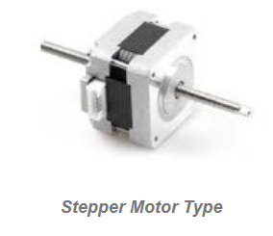
Actuators
Stepper Motor Actuators
Helpful in realizing repetitive rotating activities within robots. These types of actuators are a combination of both DC & servo motor actuators
Examples of Actuator use
Move car seats forwards & backward
Open automatic doors, computer disk drives opening and closing
An essential component of a robot that works as the joint to move the robot, rotate its arm up/down
Summary: actuators changes electrical energy into mechanical motions

Slide 20
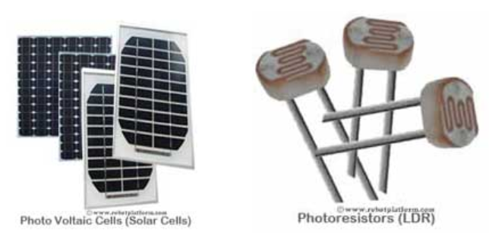
Sensors
Provide data relating to the environment and help the robot perform its programmed work
Help a robot communicate with its external world, or control its own internal system
Sensors can provide information about:
Distance measurements
pressure
Light
Humidity
Sound
Heat
Chemicals
External forces
Object proximity
Objects Orientation
Magnetic and electric field presence
Etc.
Notes:
https://www.robotplatform.com/knowledge/sensors/types_of_robot_sensors.htmlhttps://www.robotplatform.com/knowledge/sensors/types_of_robot_sensors.html

Slide 21
Analog Sensors vs. Digital Sensors
The output generated from sensors can be either analog signals or digital signals. Sensor circuits are designed to monitor these changes and provide a voltage difference.
Analog Sensors
produce a change in electrical property to signify a change in the environment.
The change can be a variation in
Voltage
Current
Resistance
Charge
Capacitance
Notes:
https://www.robotplatform.com/knowledge/sensors/types_of_robot_sensors.htmlhttps://www.robotplatform.com/knowledge/sensors/types_of_robot_sensors.html

Slide 22
Analog Sensors vs. Digital Sensors
Digital Sensors
Unlike Analog sensors, digital sensors produce discrete digital pulses for a change in the environment. The output of this sensor can be either “ON” or “OFF”, i.e. it can be either 1 or 0.
Note:
All modern microcontrollers have Analog to Digital converter circuitry built-in
In a Photoresistor, the resistance in a Photoresistor changes with the amount of light falling on it
The Photoresistor circuitry creates an analog voltage value based on the change in resistance and an analog signal is fed into the microcontroller
This analog signal, if required can be further converted into a digital value and processed as per the
Notes:
https://www.robotplatform.com/knowledge/sensors/types_of_robot_sensors.htmlhttps://www.robotplatform.com/knowledge/sensors/types_of_robot_sensors.html

