Slide 1
Chapter 2
Introduction to Human Geography (2018)
University of North Georgia Press
POPULATION
Lecture Notes by Dorrell, Henderson, Lindley, & Connor.

Slide 2
Chapter 1: Introduction
STUDENT LEARNING OUTCOMES
By the end of this section, the student will be able to:
Understand: the spatial organization of the human population
Explain: the dynamics of population as they are reflected in fertility, morbidity, and mortality
Describe: the relationship between population and other spatial phenomena such as living standards, agriculture, and health
Connect: development, migration and population as a fluid self-balancing system
Introduction to Human Geography (2018). Dorrell, Henderson, Lindley, & Connor. University of North Georgia Press.

Slide 3
Chapter 2: Population
CHAPTER OUTLINE
2.1 Introduction
2.2 Thinking About Population
2.3 Population and Development
2.4 Population is Dynamic
2.5 The Demographic Transition
2.6 Measuring the Impact of Population
2.7 Future Population
2.8 Geography of Health
Introduction to Human Geography (2018). Dorrell, Henderson, Lindley, & Connor. University of North Georgia Press.

Slide 4
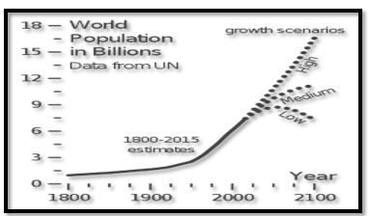
2.1 Introduction

Slide 5
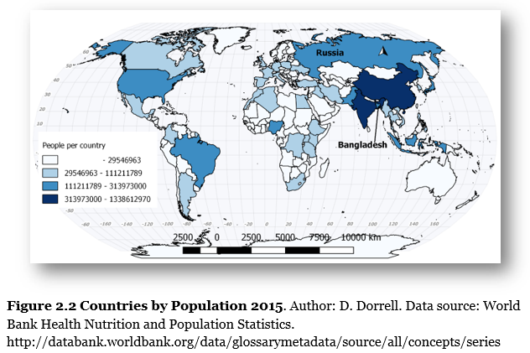
Russia and Bangladesh have similar populations

Slide 6
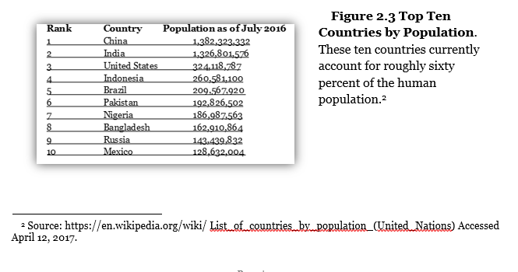
What countries are the biggest?

Slide 7
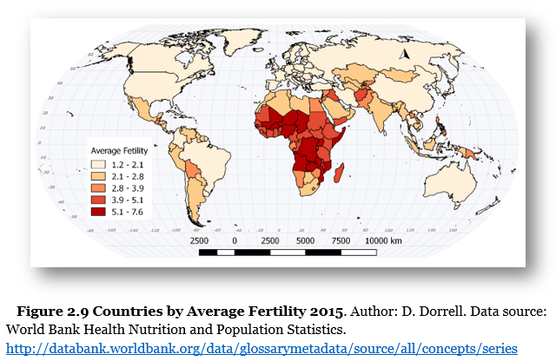
Replacement levels?

Slide 8
The Greeks and Ecumene
2.2 Thinking About Population
AKA Goldilocks
Not too hot, nor too cold, just right
In other words, the part of the world they themselves inhabited

Slide 9
Thinking about population
Malthus wrote:
“Population, when unchecked, increases in a geometrical ratio”
In other words, we will breed ourselves into poverty.
Boserup wrote:
“The power of ingenuity would always outmatch that of demand”
We always find a way to feed ourselves.

Slide 10
Malthus’ Assumptions
1. Humans would not voluntarily limit their reproduction.
2. Farming technology would suddenly stop advancing.
3. Food distribution systems would not improve.
4. Land would become unusable from overuse.

Slide 11
Malthus’ Assumptions
1. Humans would not voluntarily limit their reproduction.
2. Farming technology would suddenly stop advancing.
3. Food distribution systems would not improve.
4. Land would become unusable from overuse. Maybe?

Slide 12
Who was right?
Malthus
Locally and immediately
Local resource crises are still common.
Technological improvements often lag behind population increases.
Boserup
Globally and over time
Our ability to provide for ourselves has dramatically increased over time.
No rational person would compare the lifestyle of current developed countries with that of the past.

Slide 13
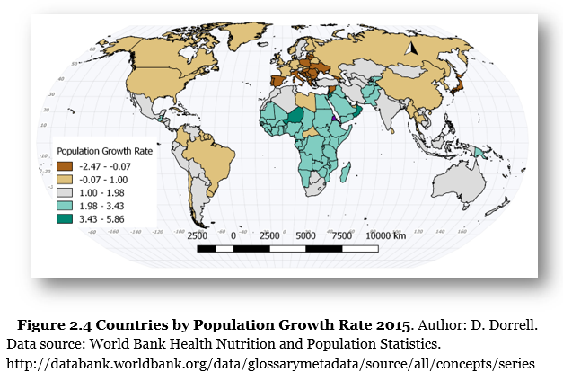
What places are growing fastest?
2.3 Population and Development

Slide 14
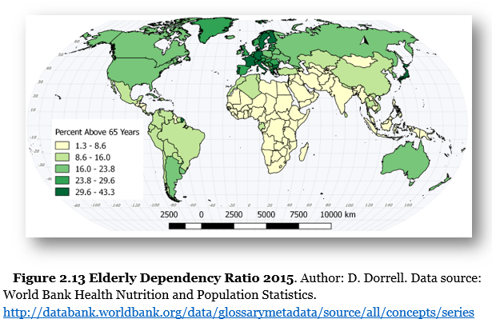
What kinds of costs are associated with large elderly populations?
Remember that life expectancy is much shorter here.

Slide 15
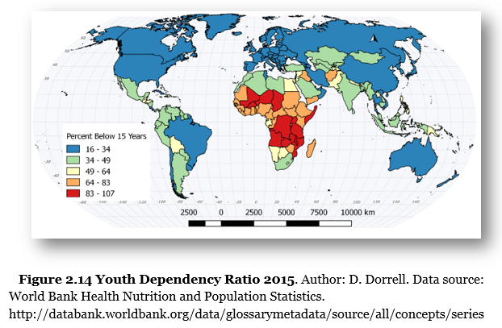
What kinds of costs are associated with large young populations?
Schooling is expensive and these places are very poor.

Slide 16
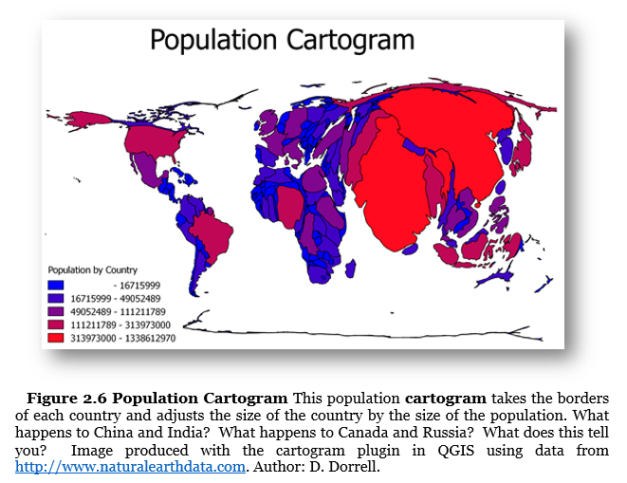
Population is dynamic- Overpopulation?
2.4 Population is Dynamic
China has a very large population, but it feeds itself. Sub-Saharan Africa has half the population of China, but is the most famine-prone part of the world.

Slide 17
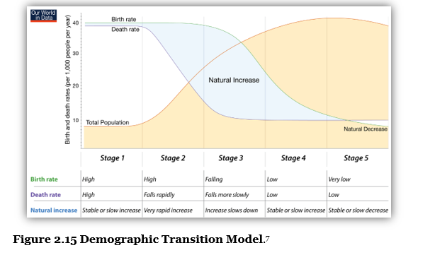
2.5 The Demographic Transition
Mexico is here
We are at the end of this stage
Yemen is here
Pre-industrial
Japan is here

Slide 18
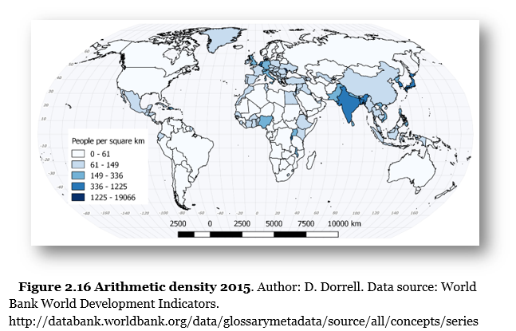
Measuring Density 1
2.6 Measuring the Impact of Population

Slide 19
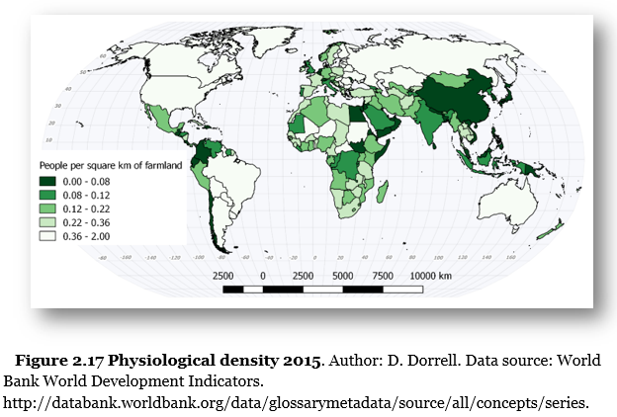
Measuring Density 2

Slide 20
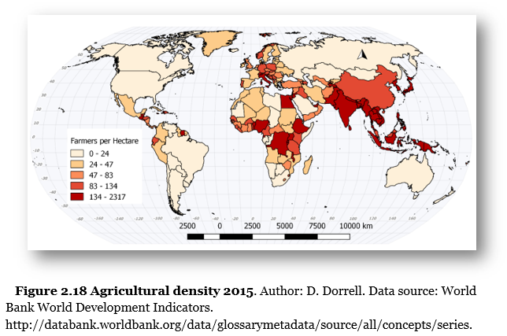
Measuring Density 3

Slide 21
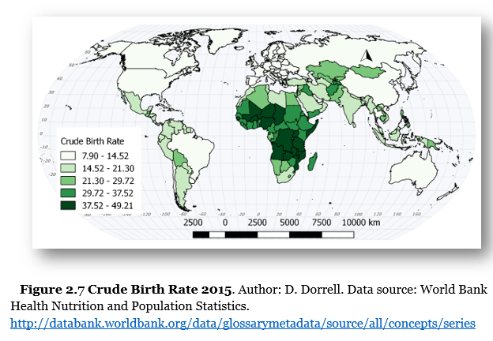
The places growing the fastest are the poorest, Why?
2.7 Future Population

Slide 22
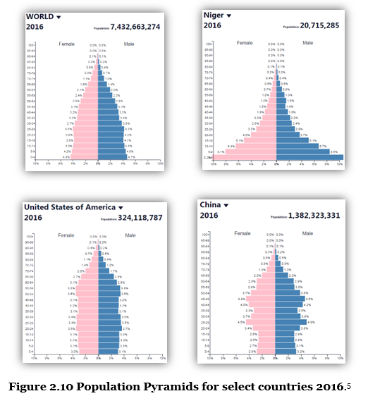
Population pyramids now

Slide 23
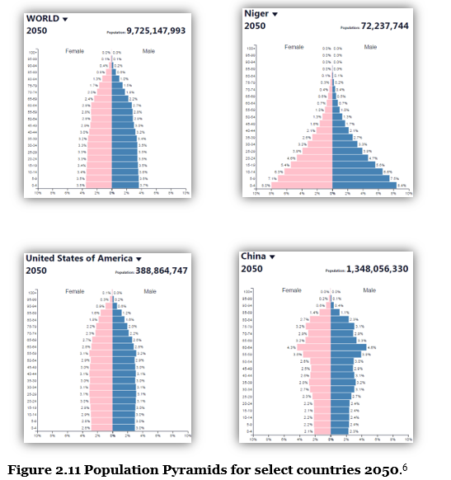
Population pyramids
2050

Slide 24
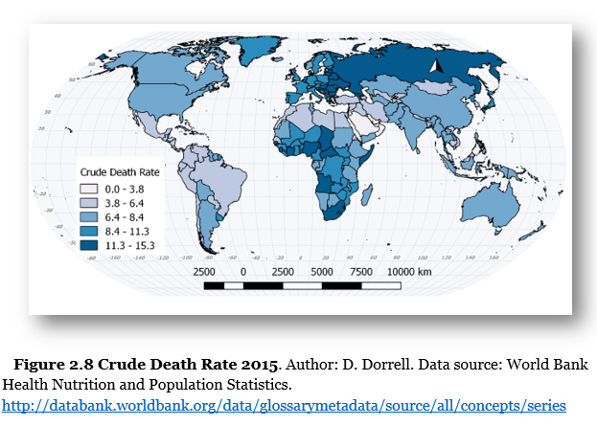
Crude Death Rate
2.8 Geography of Health
Eastern Europe has a Crude Death Rate similar to much poorer countries in Africa. Why?

Slide 25
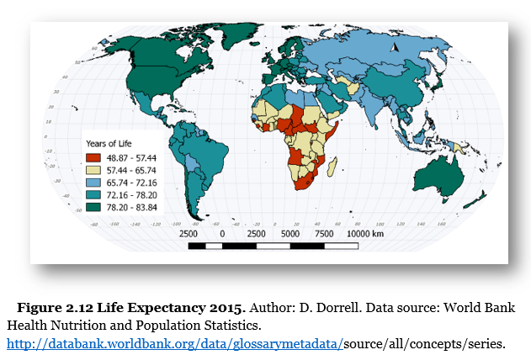
A 35 year difference in average lifespan!

Slide 26
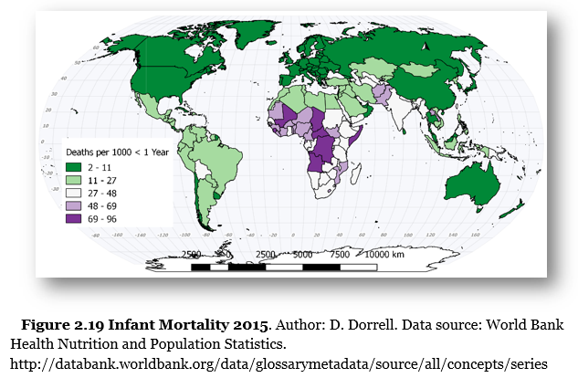
Developing world problems 1

Slide 27
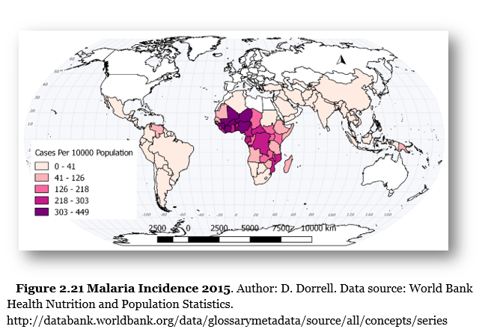
Developing world problems 2

Slide 28
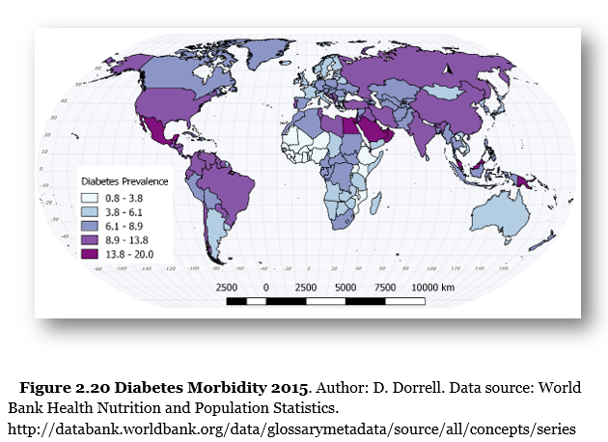
Developed world problems

Slide 29
2.X Documentary Film List for Population
Hans Rosling—Global Population Growth
https://fod-infobase-com.us1.proxy.openathens.net/p_ViewVideo.aspx?xtid=48535&tScript=0
Do it for Denmark
https://youtu.be/vrO3TfJc9Qw
Coming of Age in Aging America
https://ggc.kanopy.com/video/coming-age-america
Population Boom
https://ggc.kanopy.com/video/population-boom

Slide 30
Chapter 2 END
Introduction to Human Geography (2018)
University of North Georgia Press
POPULATION
Lecture Notes by Dorrell, Henderson, Lindley, & Connor.

