Slide 1
Chapter 5
Introduction to Human Geography (2018)
University of North Georgia Press
LANGUAGE
Lecture Notes by Dorrell, Henderson, Lindley, & Connor.

Slide 2
Chapter 5: Language
STUDENT LEARNING OUTCOMES
By the end of this section, the student will be able to:
Understand: the differing bases of ethnic identity
Explain: the relationship between ethnicity and personal identity
Describe: the degrees of relevance of ethnicity in a society
Connect: ethnicity, race and class as they relate to political power
Introduction to Human Geography (2018). Dorrell, Henderson, Lindley, & Connor. University of North Georgia Press.

Slide 3
Chapter 5: Language
CHAPTER OUTLINE
5.1 Introduction
5.2 Language and its Relationship to Culture
5.3 Classification and Distribution of Languages
5.4 Language in the Physical, Business and Digital Worlds
5.5 Summary
Introduction to Human Geography (2018). Dorrell, Henderson, Lindley, & Connor. University of North Georgia Press.

Slide 4
5.1 Introduction
Language is central to daily human existence. It is the principal means by which we conduct our social lives.
It is the tool we use to plan our lives, remember our past, and express our cultural identities.
Language is embedded in cultural practices and, at the same time, symbolizes cultural reality itself.
Notes:
Source: https://genographic.nationalgeographic.com/human-journey/

Slide 5
How are languages related.
Family (e.g. Indo-European, distantly related)
Branch (e.g. Germanic)
Subgroup (e.g. West Germanic)
English
Dialect (e.g. American English)

Slide 6
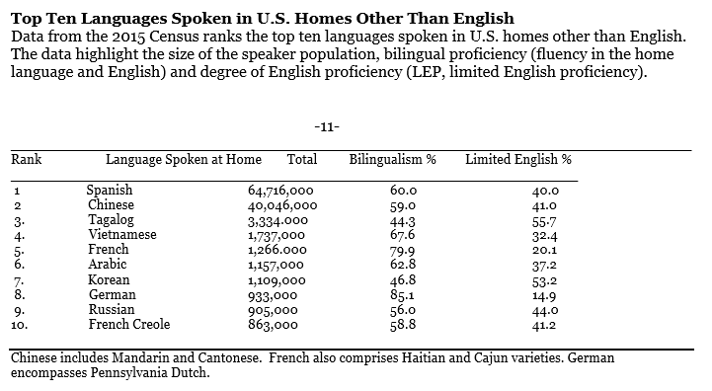
5.2 Language and its Relationship to Culture
Language is a component of culture. Different groups may identify very closely with a language, e.g. the Basques in Spain, or the relationship may be less immediate, as we see in the Cajuns of Louisiana, most of whom no longer speak French.

Slide 7
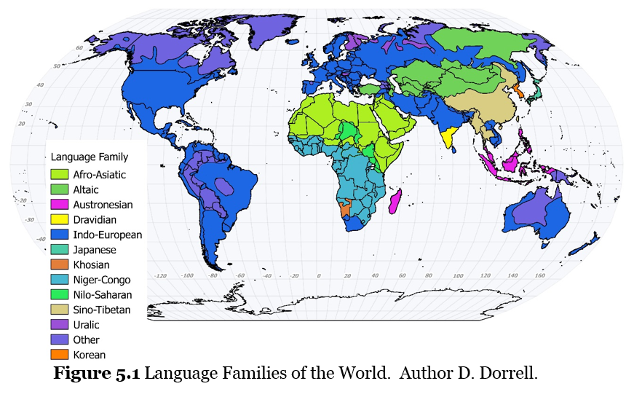
5.3 Classification and Distribution of Languages

Slide 8
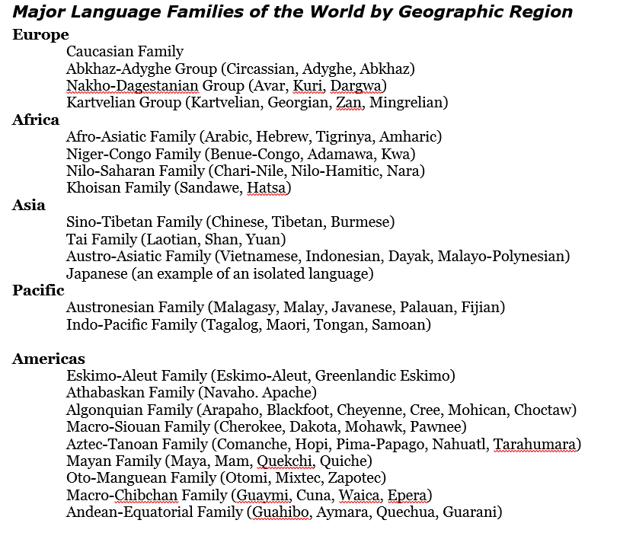

Slide 9
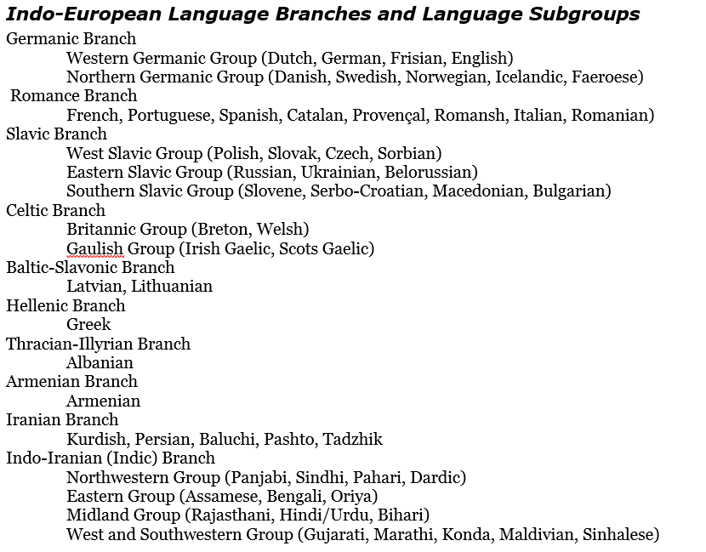

Slide 10
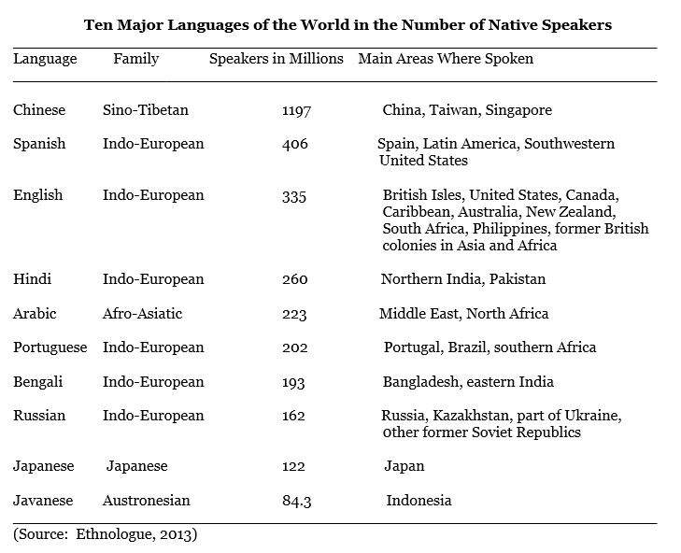
5.4 Language in the Physical, Business and Digital Worlds

Slide 11
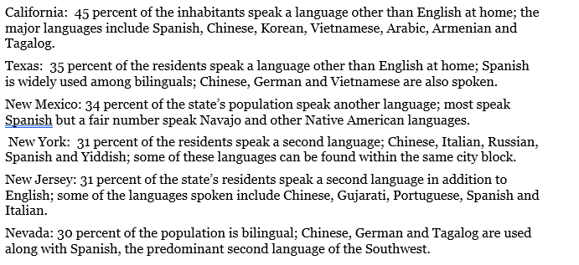
Other languages in the United States

Slide 12
The world’s language
Lingua franca is a language used to make communication possible between people who do not share a native language.
Right now, English is the global lingua franca, and it is likely to remain so for some time.
It is dominant on the Internet, in research papers and in global news broadcasts.

Slide 13
The use of different social media technologies (Facebook, Twitter, LinkedIn, Snapchat, among others) allows for online interaction between many senders and receivers. Users can create and share information, ideas, photos, career interests, and other concerns via virtual communities and networks.
Such global platforms with globalized language is a fairly new phenomenon.

Slide 14
5.5 Summary
Language is a mental capacity that people to produce and understand countless number of utterances which include grammatical elements like words, phrases and sentences.
Language is a symbol of social identity and serves to express ideas, beliefs and attitudes shared by a cultural group.
It is reflected in cultural stereotypes, notions about different languages, and behaviors during speech situations which presuppose the use of cultural scripts.
Languages are commonly classified according to membership in a language family such as Indo-European, Sino-Tibetan, Indo-Pacific, Mayan, Niger-Congo.
Members within a family are further subdivided into branches (Germanic, Slavic, Finno-Ugric, Indo-Iranian) and the branches into subgroups (English is in the Germanic branch).
Notes:
Source: https://genographic.nationalgeographic.com/human-journey/

Slide 15
5.X Documentary Film List for Language
No Béarla Series 1, Episode 1 (2011).
https://www.youtube.com/watch?v=eyll-bBZzyk
How the Basque Language has Survived (2018).
https://www.pri.org/stories/2018-05-16/how-has-basque-language-survived
Constant Change The Spread of Language Part of the Series: Speaking In Tongues
https://ggc.kanopy.com/video/speaking-tongues-history-language-episode-2-constant-change
Language and Discrimination (2011):
https://fod-infobase-com.us1.proxy.openathens.net/p_ViewVideo.aspx?xtid=155966&tScript=0

Slide 16
Chapter 5 END
Introduction to Human Geography (2018)
University of North Georgia Press
LANGUAGE
Lecture Notes by Dorrell, Henderson, Lindley, & Connor.

