Slide 1

Waves

Slide 2
Waves
In general, a wave is a travelling disturbance of one or more physical quantities
A wave transfers energy though matter and/or space
Mechanical Waves: sound waves, seismic waves
(need a medium to propagate)
ElectroMagnetic (EM) waves: radio signal, visible light waves, x-rays
Note
Wave-Particle duality of light

Slide 3
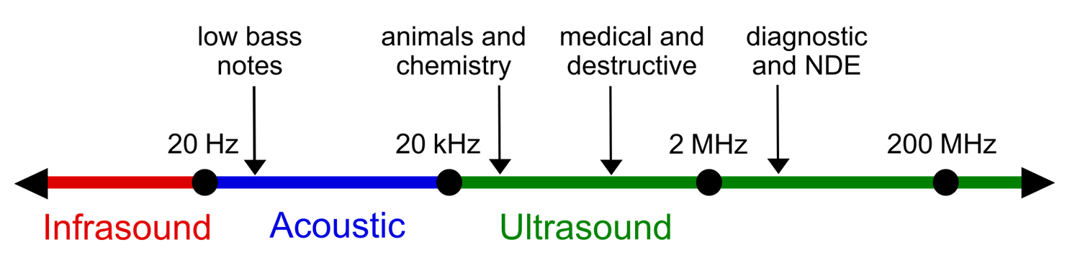
Sound waves
Sound wave
Is a periodic change (oscillations) in pressure (due to particle movements), that travels in a medium
Sound may be viewed as oscillations of medium’s particles
Medium’s particles do not move permanently in space from one location to another, they oscillate about a central position
Humans can hear oscillations of medium’s particles in a frequency range of 20 Hz to 20,000 Hz
Sound waves with frequency > 20,000 Hz: Ultrasonic waves
Sound waves with frequency < 20 Hz: Infrasonic waves
Notes:
https://en.wikipedia.org/wiki/Sound

Slide 4
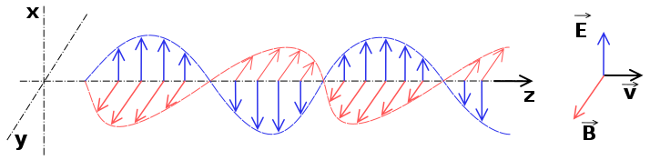
Light waves
Are ElectroMagnetic (EM) waves of any wavelength
Electromagnetic waves have oscillating electromagnetic (EM) field which propagate through space and carry energy
Humans can see light waves (EM oscillations) a frequency range of 420 to 750 Terahertz (THz)
Notes:
https://en.wikipedia.org/wiki/Electromagnetic_radiation

Slide 5
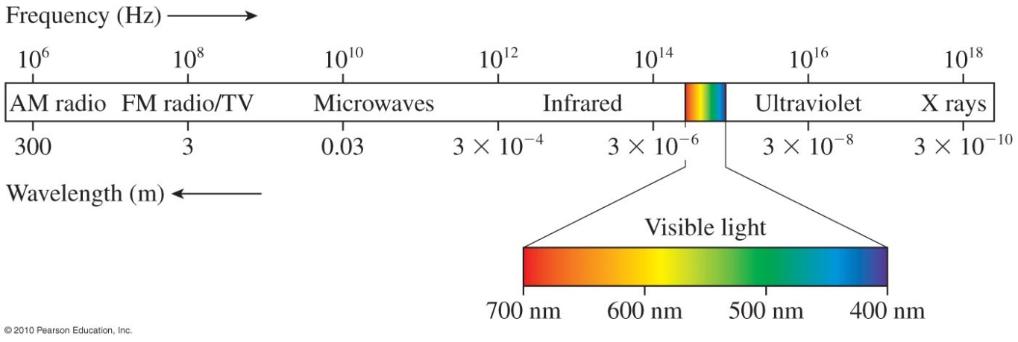
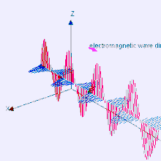
EM spectrum
Speed of all EM waves (v) = 3 x 10^8 m/s
Infrared light: Sound waves with frequency < 420 TeraHz
Ultraviolet light: Light waves with frequency > 750 TeraHz
Tera = 1x10(^12)

Slide 6
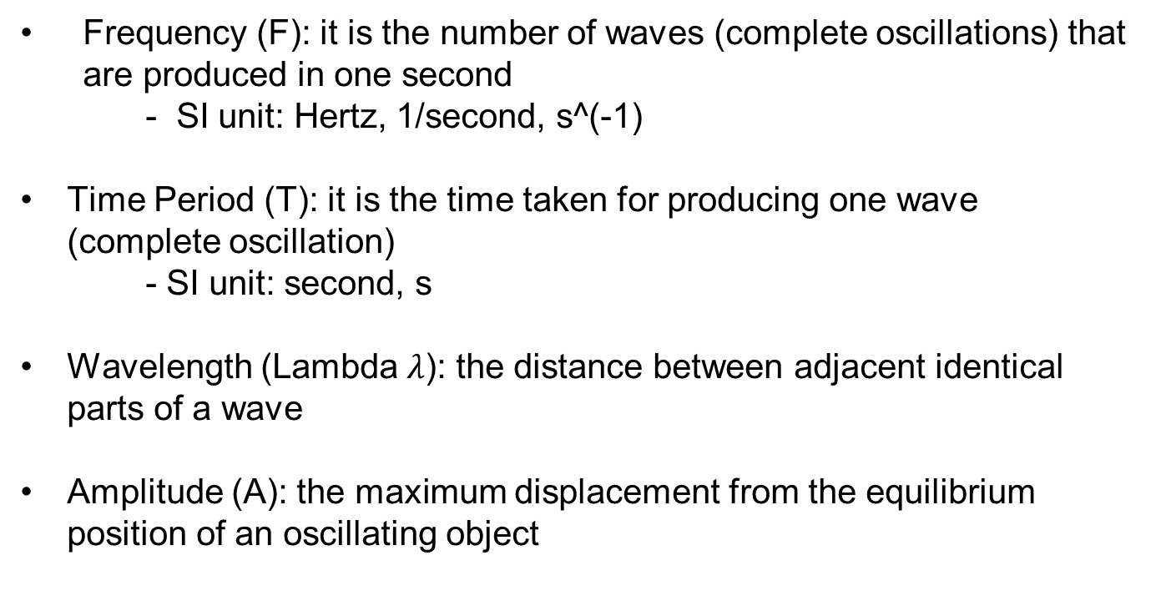
Waves related quantities
Frequency (F): it is the number of waves (complete oscillations) that are produced in one second
    - SI unit: Hertz, 1/second, s^(-1)
    Time Period (T): it is the time taken for producing one wave (complete oscillation)
    - SI unit: second, s
    Wavelength (Lambda $λ$): the distance between adjacent identical parts of a wave
    Amplitude (A): the maximum displacement from the equilibrium position of an oscillating object

Slide 7
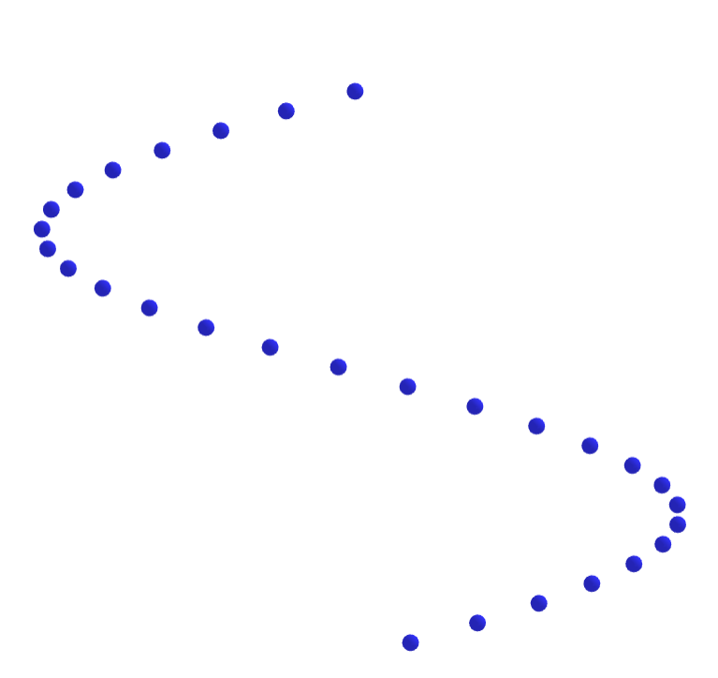
Visualizing waves from oscillation of particles
https://ophysics.com/w0.html

Slide 8
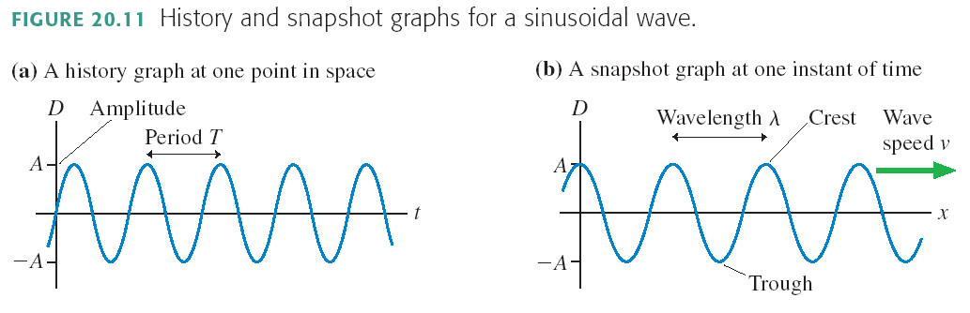
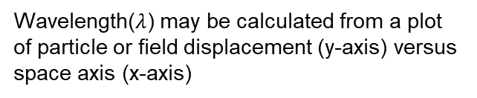
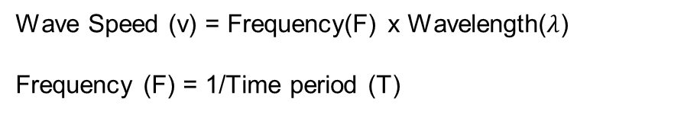
Relationship between Frequency (F), wavelength (Lambda) and wave speed (v)
Time period (T) may be calculated from a plot of particle or field displacement (y-axis) versus time (x-axis)
Wavelength($λ$) may be calculated from a plot of particle or field displacement (y-axis) versus space axis (x-axis)
Important relationships
Wave Speed (v) = Frequency(F) x Wavelength($λ$)
Frequency (F) = 1/Time period (T)
Notes:
https://en.wikipedia.org/wiki/Thermistor

Slide 9
Waves Example Problem
A student takes a 30.00-m-long string and attaches one end to the wall in the physics lab. The student then holds the free end of the rope. The student produces waves down the string by moving the end of the string up and down with a frequency of 2.00 Hz. The maximum displacement of the end of the string is 20.00 cm. The first wave hits the lab wall 6.00 s after it was created.
What is the speed of the wave?
What is the period of the wave?
What is the wavelength of the wave?
Notes:
https://openstax.org/books/university-physics-volume-1/pages/16-1-traveling-waves

Slide 10
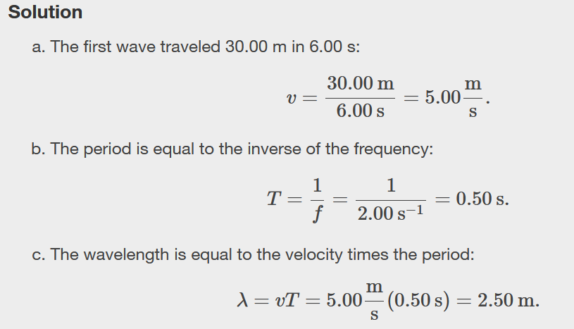
Notes:
https://openstax.org/books/university-physics-volume-1/pages/16-1-traveling-waves

Slide 11
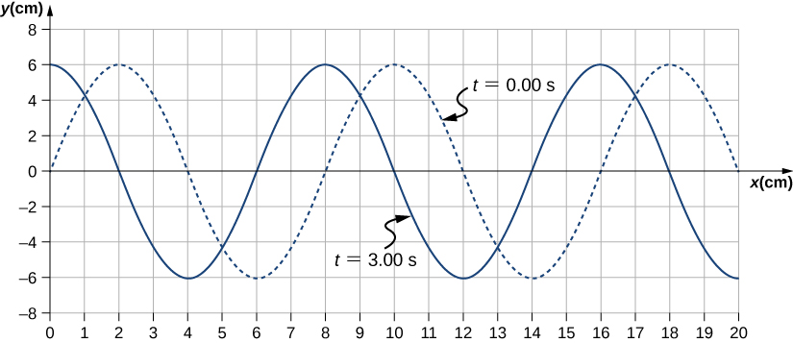
Waves Example Problem
A transverse wave propagates through a spring with a constant wave speed. The graph shows the height of the spring (y) versus the position (x) on the spring.
Also, the figure shows the height of the spring versus the x-position at t=0.00s as a dotted line and the wave at t=3.00s as a solid line. Assume the wave has not traveled more than 1 wavelength in this time.
(a) Determine the wavelength and amplitude of the wave
(b) If the wave speed is 2 cm/s, calculate the period and frequency of the wave
Notes:
https://openstax.org/books/university-physics-volume-1/pages/16-1-traveling-waves

Slide 12
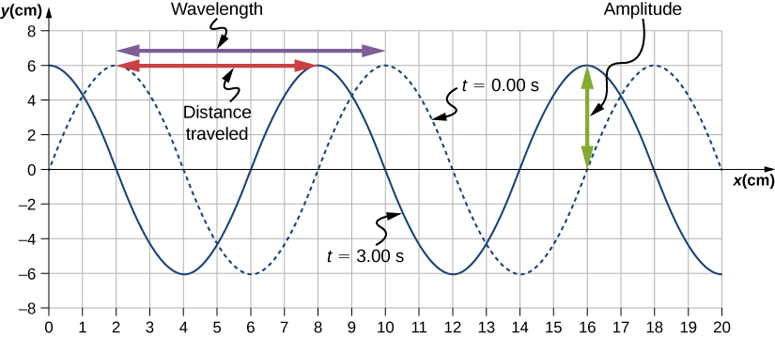
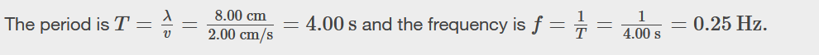
Solution
(a) Read the wavelength from the graph, looking at the purple arrow. Read the amplitude by looking at the green arrow. The wavelength is λ=8.00cm and the amplitude is A=6.00cm.
Notes:
https://openstax.org/books/university-physics-volume-1/pages/16-1-traveling-waves

Slide 13
Temperature dependence of speed of sound waves
In air, the speed of sound is:
At room temperature, speed of sound wave (v) =343 m/s
In general, sound travels faster through solid than liquid, and faster through liquid than gases
Notes:
https://en.wikipedia.org/wiki/Resistance_thermometer
https://learn.adafruit.com/tmp36-temperature-sensor

Slide 14
Sound Waves Example Problem
Q) Which of the following actions will increase the speed of sound in air? And why?
      Decreasing the air temperature
      Increasing the frequency of the sound
      Increasing the air temperature
      Increasing the amplitude of the sound wave
      Reducing the pressure of the air
Notes:
Answer: C

Slide 15
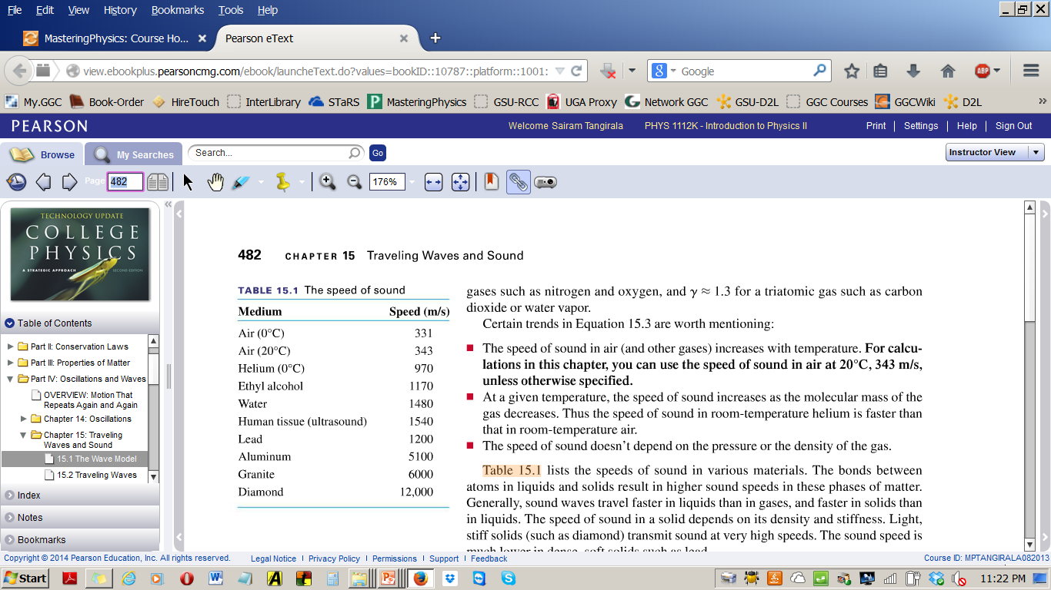
Dependence of speed of sound waves on materials
In general, as the density of materials increases, the speed of sound also increases
Speed of sound in solids > speed of sound in liquids > speed of sound in gases
Notes:
https://en.wikipedia.org/wiki/Resistance_thermometer
https://learn.adafruit.com/tmp36-temperature-sensor

Slide 16
Sound Waves Example Problem
Q) A radiologist is interested in obtaining an ultrasound image of a patient’s liver. For this, she plans to use sound waves of wavelength 0.50 mm. Calculate the frequency of the sound waves produced by the ultrasound imaging equipment using the speed of sound information in below table.
Notes:
3.1 MHz

Slide 17
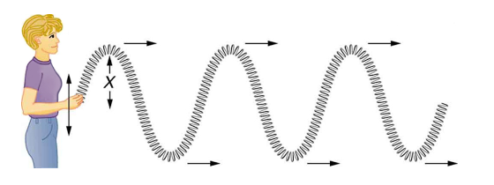
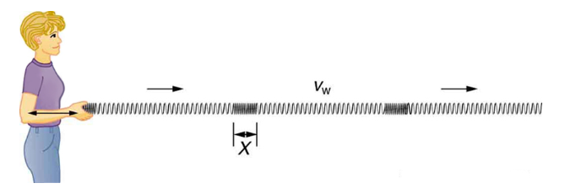
Transverse and Longitudinal Waves
Transverse wave: is a wave whose oscillations are perpendicular to the direction of the wave
Longitudinal wave: are waves in which the vibration of the medium is parallel ("along") to the direction the wave
Transverse wave,
Longitudinal wave
Notes:
https://en.wikipedia.org/wiki/Thermistor

Slide 18
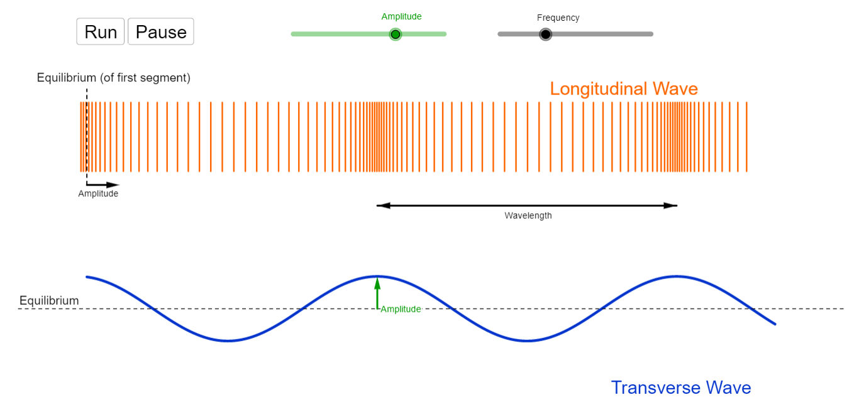
Visualizing Transverse and Longitudinal Waves
https://ophysics.com/w6.html

Slide 19
Travelling Waves and Standing Waves
Waves can be periodic, in which case those quantities oscillate repeatedly about an equilibrium (resting) value at some frequency
When the entire waveform moves in one direction, it is said to be a traveling wave
A pair of interfering periodic waves traveling in opposite directions makes a standing wave
We will see talk more about standing waves later in the chapter
Notes:
https://en.wikipedia.org/wiki/Accuracy_and_precision

Slide 20
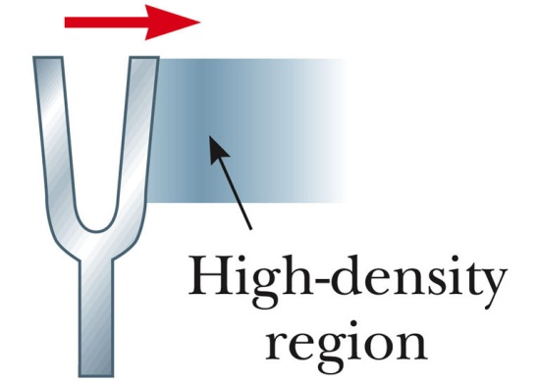
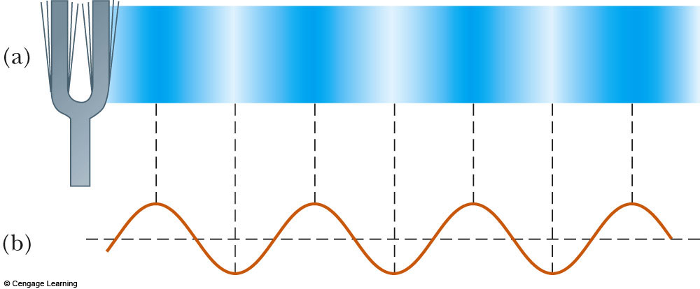
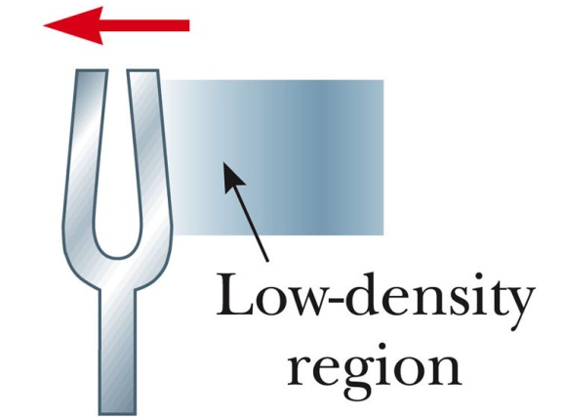
Sound is a longitudinal wave
Sound waves are longitudinal waves traveling through a medium
As the tuning fork continues to vibrate, a succession of compression and rarefactions spread out from the fork to produce sound waves
Notes:
https://en.wikipedia.org/wiki/Thermocouple

Slide 21
Energy in Mechanical Waves
The amount of energy in a wave depends on its amplitude and its frequency
Average rate of energy transfer in mechanical waves is proportional to both the square of the amplitude and the square of the frequency
Large-amplitude earthquakes (type of wave) produce large ground displacements
Loud sounds have high-pressure amplitudes and come from larger-amplitude source vibrations than soft sounds
If the energy of each wavelength is considered to be a discrete packet of energy, a high-frequency wave will deliver more of these packets per unit time than a low-frequency wave
Notes:
https://openstax.org/books/university-physics-volume-1/pages/16-1-traveling-waves

Slide 22
Energy in Mechanical Waves
If two mechanical waves have equal amplitudes, but one wave has a frequency equal to twice the frequency of the other, the higher-frequency wave will have a rate of energy transfer a factor of four times as great as the rate of energy transfer of the lower-frequency wave.
Notes:
https://openstax.org/books/university-physics-volume-1/pages/16-1-traveling-waves

Slide 23


Intensity of Sound Waves
Intensity: The average intensity (I) of a wave on a 3D spherical surface of radius ‘r’ is given by equation
Units: W/m2

Slide 24

Intensity of Sound Waves
Ratio of sound wave intensities from waves starting from one
r1
r2

Slide 25
Intensity of sound waves
Intensity level of sound waves:
Units: dB (decibel)
Io is referred to as the threshold of hearing
Io = 1x 10 -12 W/m2
In dB, the threshold of hearing = 0 dB
Jet airplane’s intensity is about 150 dB
Multiplying a given intensity by 10, is equivalent to adding 10 dB to the intensity level

Slide 26
Example Problems
Q) On one of those days, after you attended this class, you felt like shouting out your excitement in the course! You went out to the student center and at the top of your lungs ,shouted out your excitement by spending about 1 watt of energy. With this power you input in generating the sound waves, calculate the sound intensity (dB) at a distance 1 m from you. (answer: I = 0.079 Wm⁻², beta = 110dB )
Q) Calculate the intensity level for intensity 1x 10⁻⁵ W/m² (answer: 70 dB)
Q) Calculate intensity for intensity level 77 dB (answer: 5.01 E-5 W/m²)

Slide 27
Interference (Super position) of waves
When two or more waves are present at the same time at the same location, the displacement of the medium’s particles at that place is the addition of displacements due to each individua wave
Constructive interference of two identical waves produces one with twice the amplitude, but the same wavelength
Destructive interference of two identical waves produces zero amplitude, or complete cancellation
Notes:
https://en.wikipedia.org/wiki/Digital_signal_(signal_processing)

Slide 28
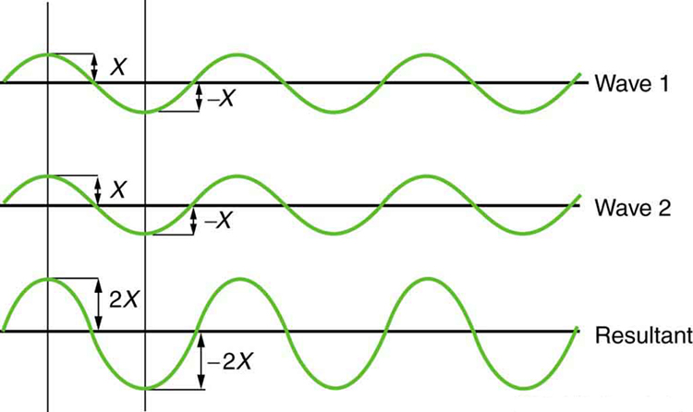
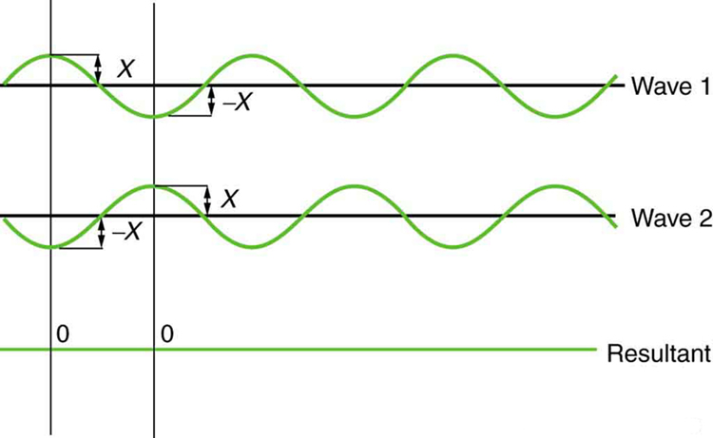
Interference (Super position) of waves
Constructive interference
Destructive interference

Slide 29
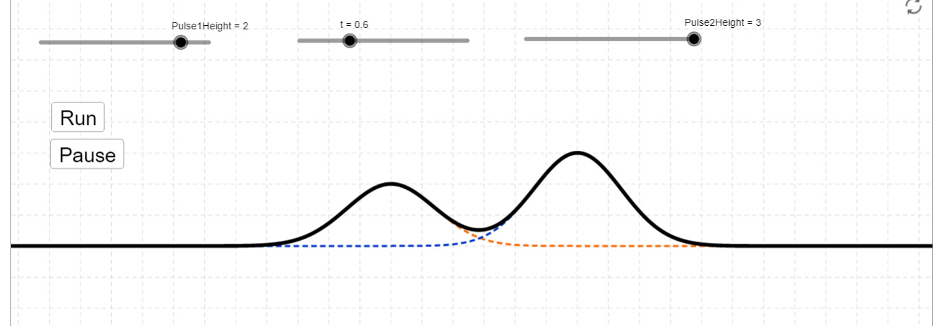
Visualizing Superposition of two waves
https://ophysics.com/w2.html

Slide 30
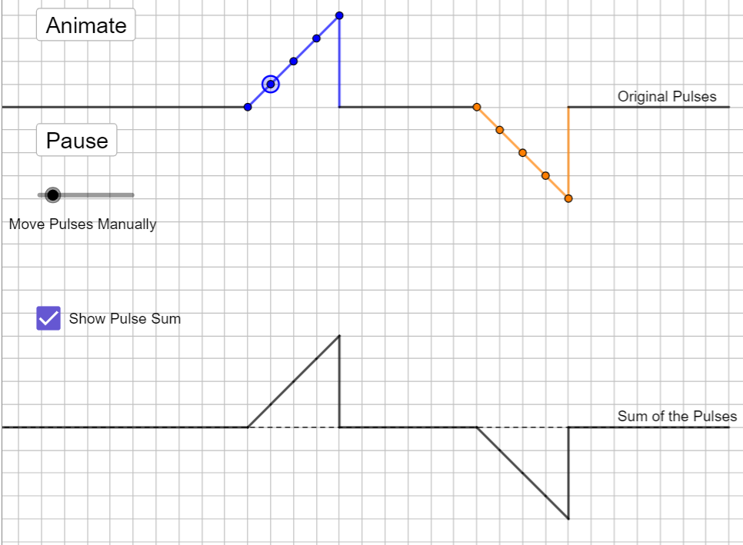
Visualizing Superposition of two waves
https://ophysics.com/w2a.html

Slide 31
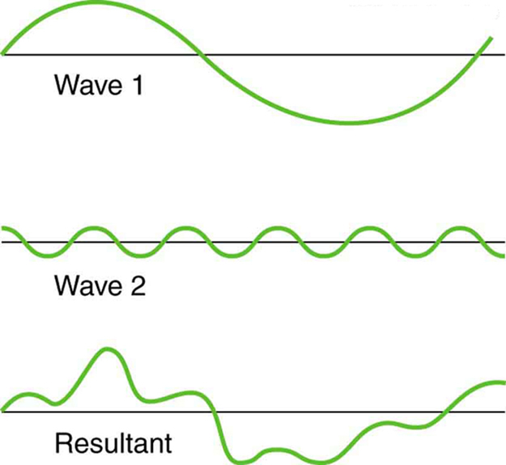
Interference (Super position) of waves
Superposition of non-identical waves exhibits both constructive and destructive interference

Slide 32
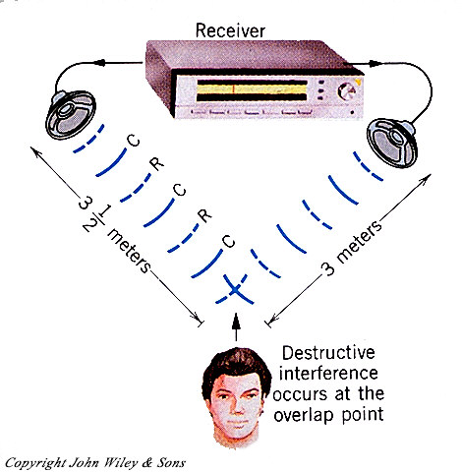
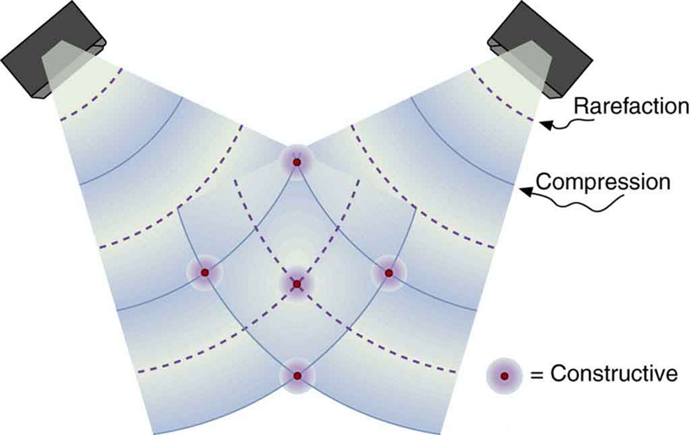
Sound waves from two speakers
These stereo speakers produce both constructive interference and destructive interference in the room
The shading is proportional to intensity

Slide 33
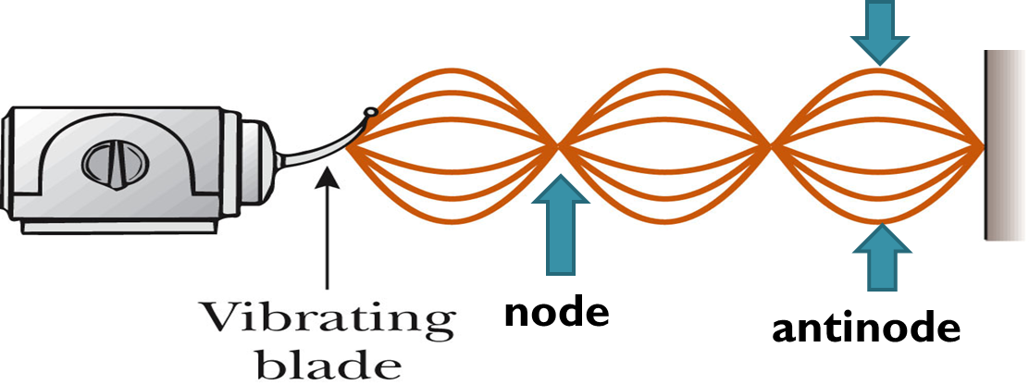
Standing Waves
When a traveling wave reflects back on itself, it creates traveling waves in both direction.
The original wave and its reflected wave interfere/superimpose
At certain frequencies called resonant frequencies, the superposed wave will appear to stand still
A node occurs where the two waves have the same magnitude of displacement with the opposite direction
An antinode occurs where the standing wave vibrates at maximum amplitude

Slide 34
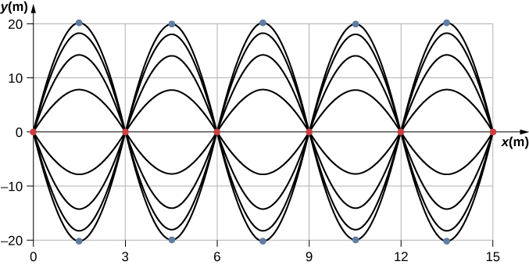
Standing Waves
When two identical waves are moving in opposite directions, the resultant wave is a standing wave
Nodes appear at integer multiples of half wavelengths
Antinodes appear at odd multiples of quarter wavelengths, where they oscillate between y=±A
The nodes are marked with red dots and the antinodes are marked with blue dots
Notes:
https://openstax.org/books/university-physics-volume-1/pages/16-6-standing-waves-and-resonance

