Slide 1

This set of slides, text, and data screenshots are under a Creative Commons Attribution 4.0 International License.
https://creativecommons.org/licenses/by/4.0/
See the final slide for details on the use of illustrative video game images in this slide deck.

Slide 2
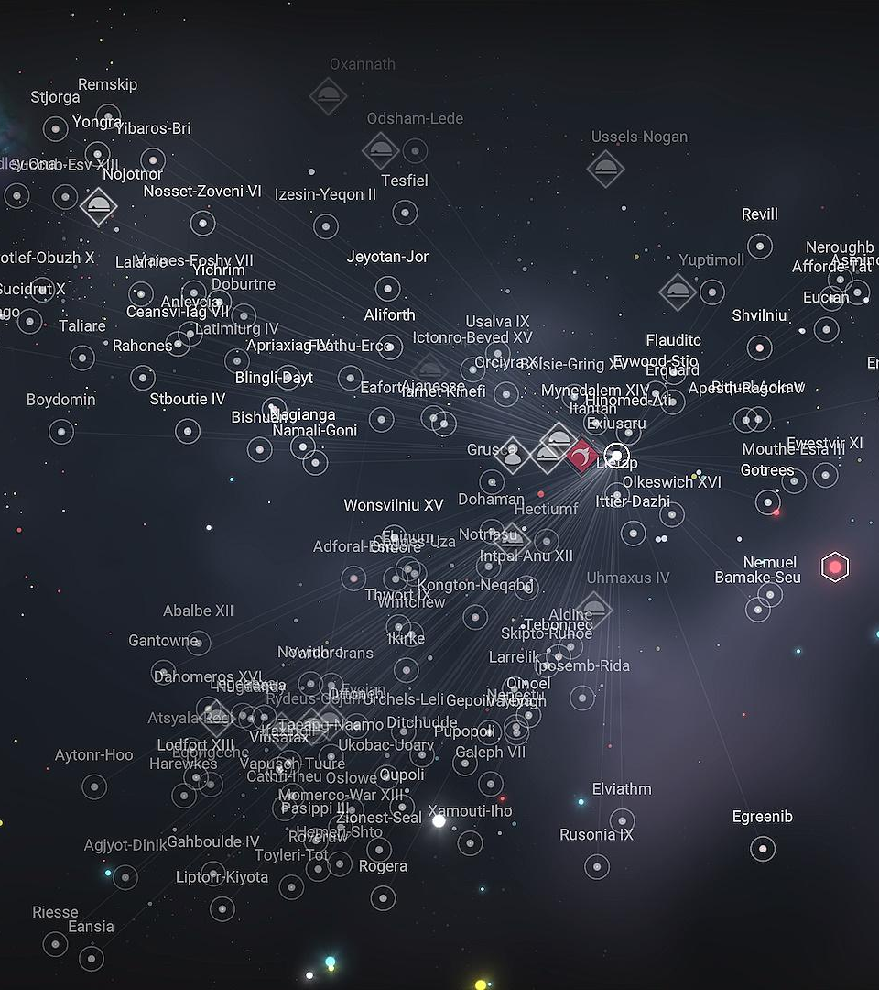
About The Scope
I don’t code! If you code, this will be a very different experience for you than what I’m presenting.
This presentation is made for folks using spreadsheets and data applications such as Power BI, Airtable, Tableau, Qlik.
If you create and host PostgreSQL, great! This probably isn’t going to help.
Notes:
A galaxy map of No Man’s Sky, a game with such a large scope that it’s unattainable in a presentation like this.

Slide 3


Quick! What are we doing?
ALG Data History and Broken Excel
From Wide Data to Tall Data
Dimension Tables and Fact Tables
The Power of the Folder
Data Relationships and Models
Dashboard Examples
Notes:
Confused but level-up-able Jack Frost from Shin Megami Tensei.

Slide 4

Old, Broken Excel: Grants Data
W I D E Data
x♾️
Formulas Crash Excel, Limits Can Be Reached
Grant Savings Columns (Savings in Fall 2016, students in Fall 2016, savings in Spring 2016, students in Spring 2016…)
Sustainability Columns (Check 1: Status, Students Per Semester, Check 2: Status, Students Per Semester…)
Grant Information Columns (Number, Institution, Project Lead, Courses, Subjects)
Per semester
Per year
Notes:
The Prince, rolling up a giant ball of stuff called a Katamari, will introduce us to the giant ball of stuff we accumulated over time in the form of Wide Data.

Slide 5
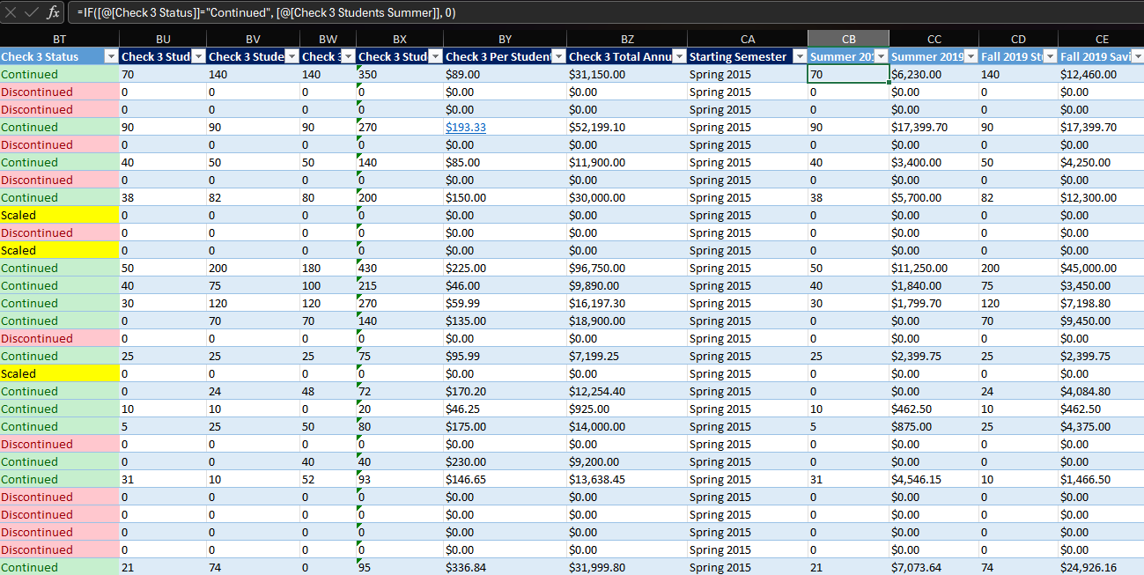

Slide 6

Old and Current Incompatible Excel:
Marking Data
Description Columns (Course Number, Institution, Instructor, Courses, Subjects, No-Cost Marking, Low-Cost Marking)
70,000+ rows, one per section
No Analysis Across Grants:
Connecting 70,000 rows with the Grants Data crashes Excel (XLOOKUP)
No Analysis Over Time: Adding another semester of sections crashes Excel
Notes:
Doshin the Giant, a very tall character for the Nintendo 64 Disc Drive, which never made it to the US, representing Tall Data, which is rare in US OER programs.

Slide 7
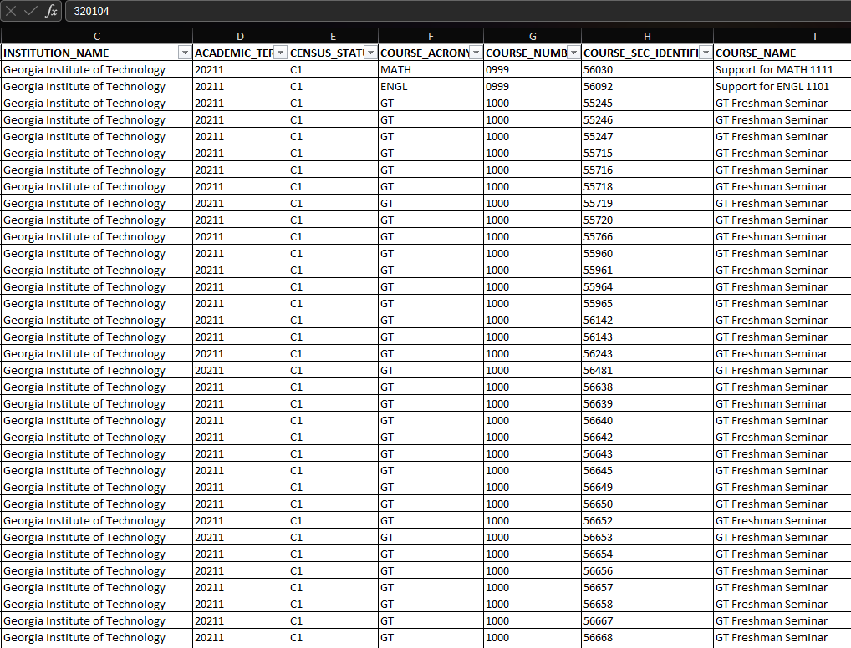
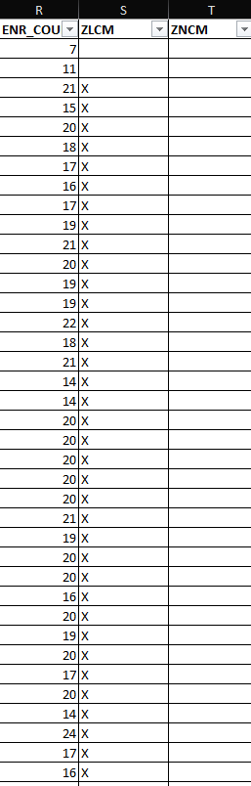

Slide 8


Wide Data Issue
Programs like Power BI were freaking out when we added a column.
We had a zillion columns (wide data) and would add more every semester. (Excel has a smaller limit for columns than rows.)
Why? Because these programs expected our columns to stay the same and our rows to expand (tall data).
This is because data has dimensions and facts.
Notes:
What happens when Nintendo’s Game and Watch Ball game has you juggle way too many things at once? The same thing that happens when you give Excel wide data.

Slide 9


Leveling Up: Dimensions and Facts
Dimensions describe what you’re measuring
In library-speak, dimension table columns are the “Metadata Fields” of dimensions
Dimension table rows are the “Metadata Entries” of dimensions
Can have many dimension tables
Facts are what you’re measuring
In business, this might be individual transactions
In OE, this would be semesters of students affected and savings per adoption (or grant project)
Usually one or two fact tables
Notes:
Our Dimension X representative, Krang from SNES Turtles in Time.

Slide 10
Leveling Up: Dimensions and Facts 2
Dimensions are w i d e .
Facts
are
T
A
L
L.
Notes:
Our Dimension X representative, Krang from SNES Turtles in Time.

Slide 11
Dimension Table: GrantInfo
Index number: super important!
Semester Awarded:
this is text, so how can it help with order?
Institution: do institutions have categories? Groups? How would you filter by these?
More separate columns?

Slide 12
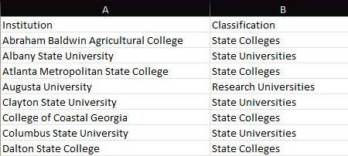
Dimension Table: InstitutionInfo
(Categorizations may be added later.
Which ones are MSIs?
Which ones are in South Georgia?)

Slide 13
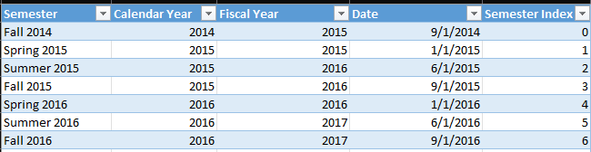
Dimension Table: SemesterInfo
Defining time in multiple ways
Same semester text as GrantInfo (to link them together)
Index: Easy way to not list semesters alphabetically

Slide 14
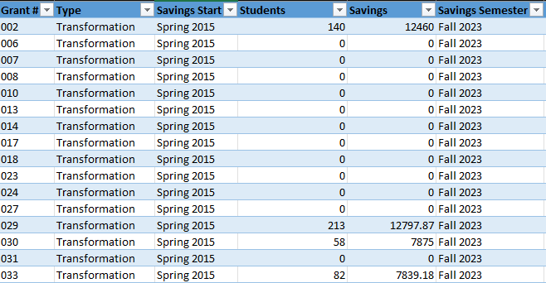
Fact Table:
Savings Data (one semester per file!)
One unique grant number per project
Created as filtered by the current Sustainability Check when created
($0 = discontinued or unknown)
Filter: only Transformation Grants have savings data

Slide 15


How Do You Put Semesters Together?
Answer: Folder = Database
Point your visualizer / data application at a folder
Let the first table define the structure of all the tables as a “model”
Make sure every table you add to the folder is the same exact structure. Tables will then join or append to the end of the list.
The folder becomes its own database of individual tables that Power BI or another visualizer can read
Voila! Add a new cleaned-up table and your application will append or join the rows to the rest.
Excel doesn’t have to manage mammoth-sized files
Notes:
The all-important treasure chest in Final Fantasy X.

Slide 16
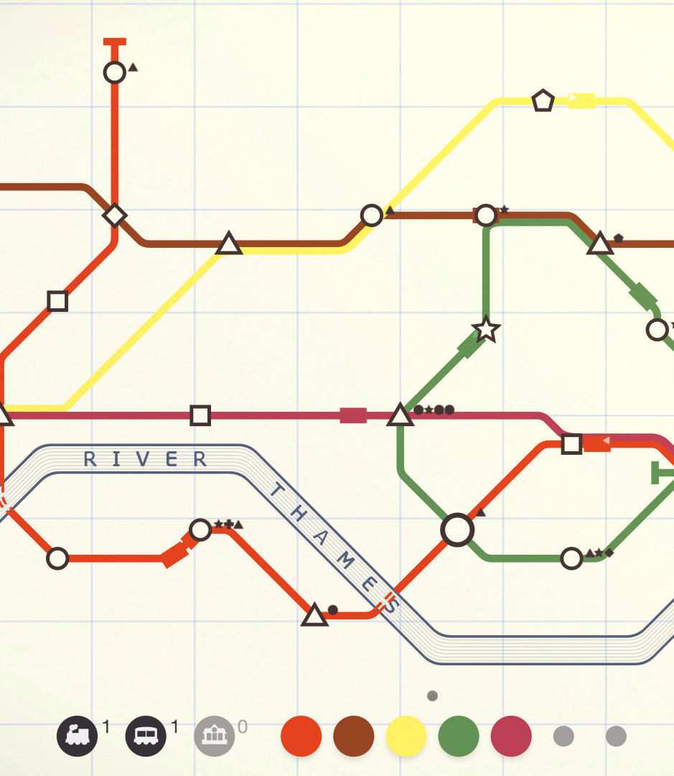
Relationships:
Connecting Dimensions and Facts
For this model to work, you need to connect tables together:
One-to-one relationship: Unique one-row value to same one-row value in another table
  Simplest
One-to-many relationship: Unique one-row value to same value in more than one row in another table
  Most common
Many-to-many relationship: Value in more than one row to same value in more than one row in another table
  Difficult for programs to manage
Notes:
The many connections you make in the game Mini Metro

Slide 17
Data Model: Your Tables With Relationships
InstitutionInfo
SemesterInfo
GrantInfo
Institution: One-to-Many
Semester: One-to-Many
Grant #: One to Many
Calculated Column: Many-to-Many
Banner Data
Grants Data

Slide 18

Connecting GrantInfo and Banner Data: Unique Identifiers
Banner data has multiple entries for one course for one institution because it’s per-section data. What can we do?
In Power BI, in both tables, concatenate Institution with Course Number in both tables to form a new “calculated column.”
Many-to-many relationship
Not recommended most of the time, but recommended for this particular instance
Used as a secondary sustainability check when surveys don’t reach every team (Are the no-cost section enrollments similar to the student estimates per semester?)
Notes:
The Many vs. Many chaos of Marvel Vs. Capcom 2

Slide 19
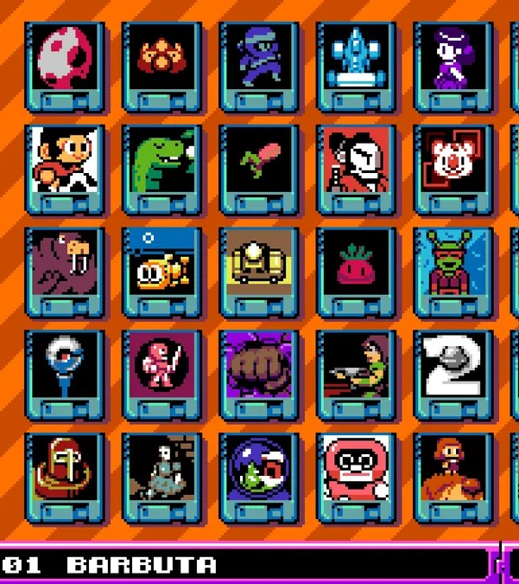
Okay, We’ve Leveled Up! Now What?
Find the grantees with the most no-cost course markings.
Find the institution with the most no-cost or low-cost course markings per grant awarded.
Bring marking and grants data together in one report and link it all to one slicer for easy analysis and printing.
Have slicers that filter by Fiscal Year, Semester, Calendar Year
Good heavens! Could we possibly disaggregate our data and do statistical analysis now? (It depends on the data you have…)
Notes:
The many great options of the new multi-game UFO 50.

Slide 20
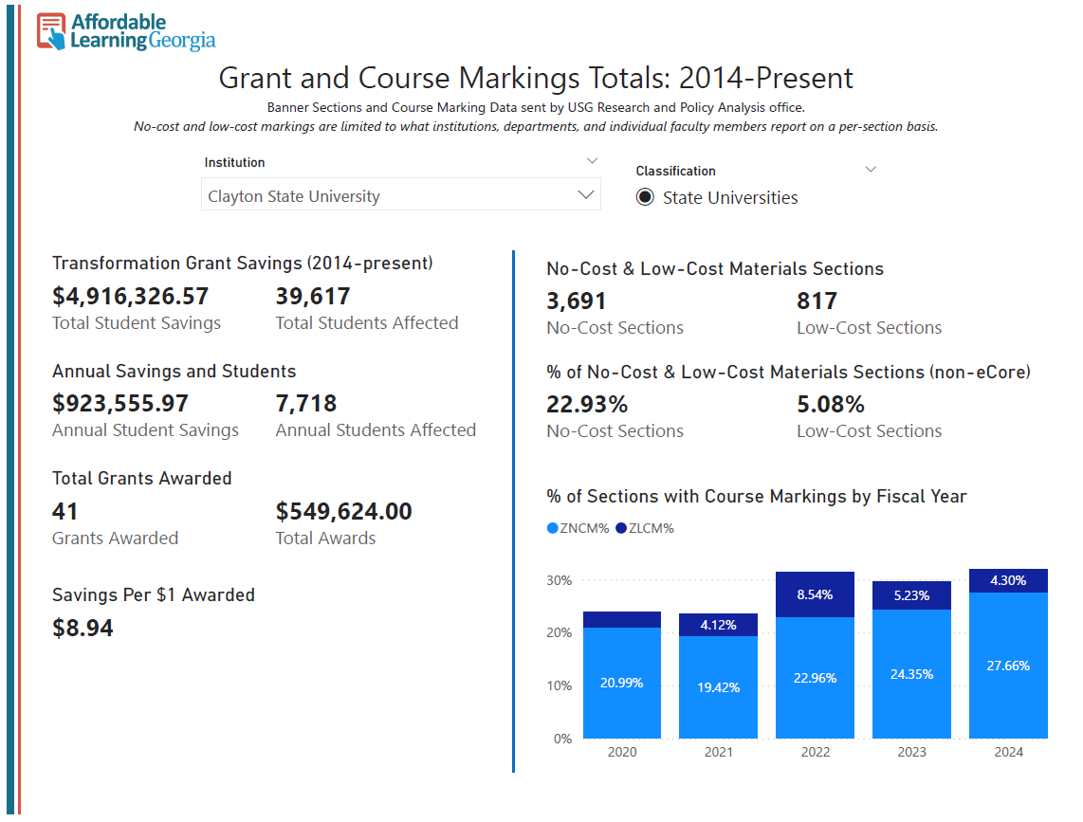
Power BI:
Linked Slicers
InstitutionInfo
Savings Data
Banner Data
GrantInfo
SemesterInfo

Slide 21
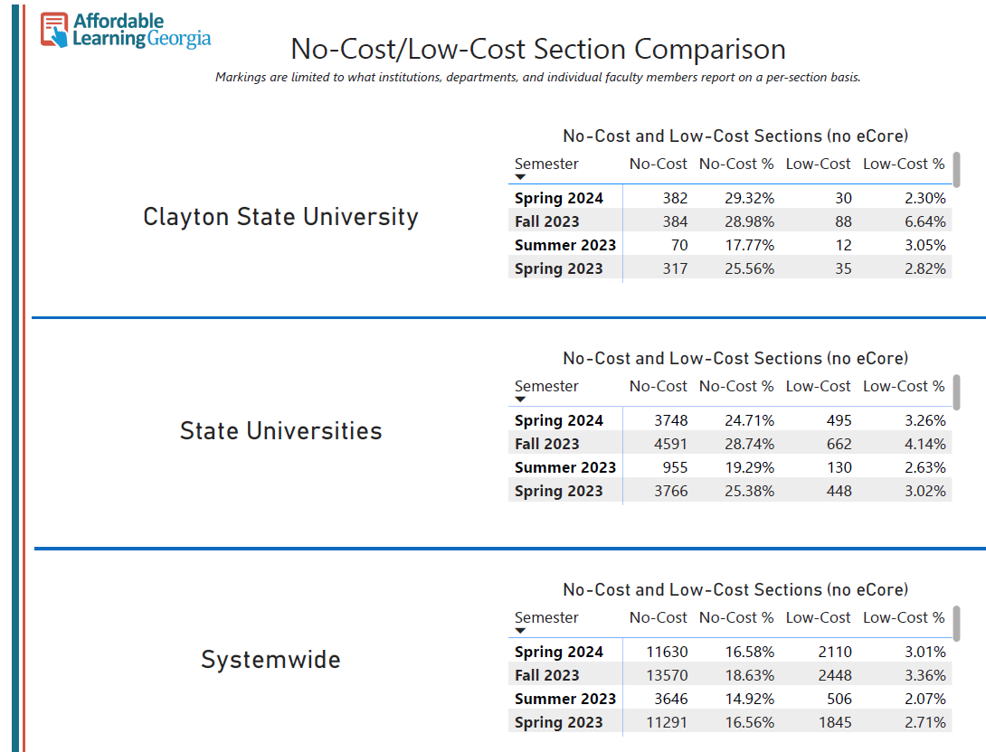
SemesterInfo
Linked Slicers
InstitutionInfo
Banner
Data

Slide 22
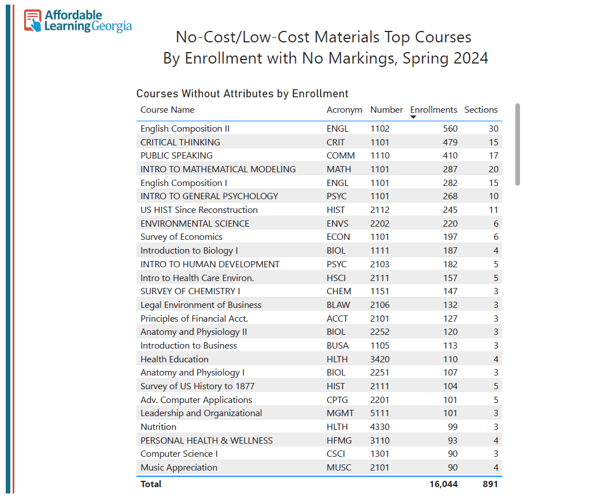
Linked Slicers
Banner Data

Slide 23
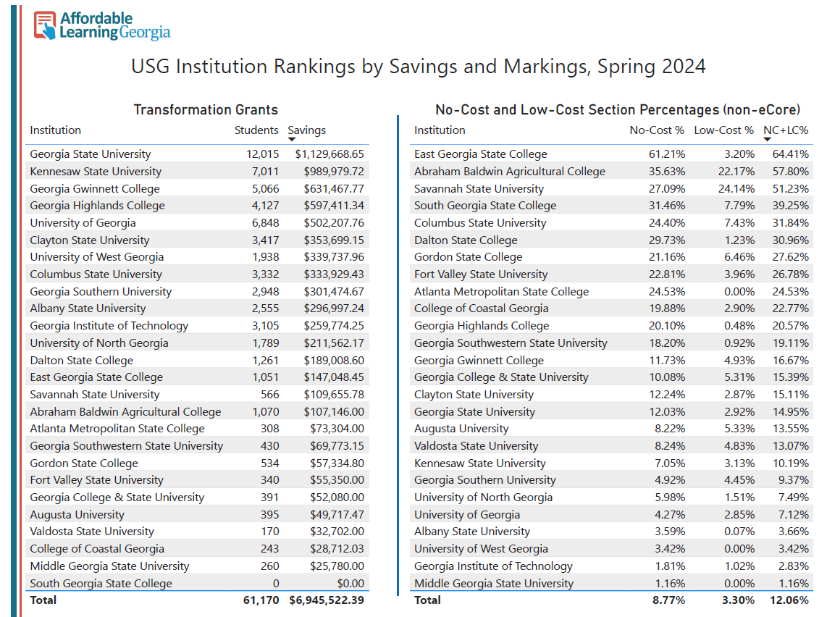
No Linked Slicers
Grants Data
Banner Data

Slide 24


Common Issues
One-to-many with a small text change (Georgia College & State University, Georgia College and State University)
Wrong data format for a column
  Our Grant Numbers are a text row. Otherwise, numbers like “584a” and “584b” wouldn’t work. Power BI will often read a column of numbers as numbers.
Uh-oh! We do need to add a column now!
  In Power BI, we delete and re-add the whole thing at this point.
  This usually makes all your visuals glitch. You’ll have to either re-point them or re-do them.
Notes:
Mr. Resetti, who gets angry for your own good in Animal Crossing, has shown up to point out an ampersand issue.

Slide 25


Dimension and Fact Templates
(& the slides!)
https://alg.manifoldapp.org/projects/leveling-up-open-education-data

Slide 26

What’s Next?
A guide, perhaps!
Updates to the OER Starter Kit for Program Managers

Slide 27

Thank You!
Jeff Gallant
Jeff.Gallant@usg.edu
LinkedIn: jeffwgallant
Notes:
As Hyakutaro Ichimonji from the arcade classic Metal Slug would say, Thank You!

Slide 28
About the Images
Various images from video games are being used in these slides! These are indicated by a note in the Notes field.
These video game images are not under a Creative Commons license. They are being used to illustrate the various feelings associated with the topics being discussed and are all-rights-reserved.
If you do not have a deliberate use for the game images, please delete them when remixing and revising.
My own screenshots of our data, such as Power BI and Excel screenshots, are under a CC BY 4.0 International License.

