Slide 1

OPEN EDUCATIONAL RESOURCES WORKSHOP 2025
Nakita Afaha
Program Manager, Affordable Learning Georgia
AI Disclosure: Workshop materials were created with assistance from ChatGPT. Building a Statewide Advocacy Network for Affordable Learning: Lessons from Georgia © 2025 by Nakita Afaha is licensed under CC BY 4.0

Slide 2


Building an Advocacy Network for Open Education in Your State
Lessons from Affordable Learning Georgia (ALG)

Slide 3
Session Outcomes
Understand what ALG is and why the Champion network was created
Learn how Champions drive meaningful change across institutions
Explore how ALG supports its network
Draft first steps to launch your own network
Notes:
You’ll leave today with ideas you can act on immediately.

Slide 4

Who’s in the Room?
Raise your hand if you are…
Faculty
Librarian
Instructional Designer / CETL staff
Administrator
Notes:
The strength of advocacy networks is that they bring these different roles together. You’ll see how that plays out in Georgia.

Slide 5
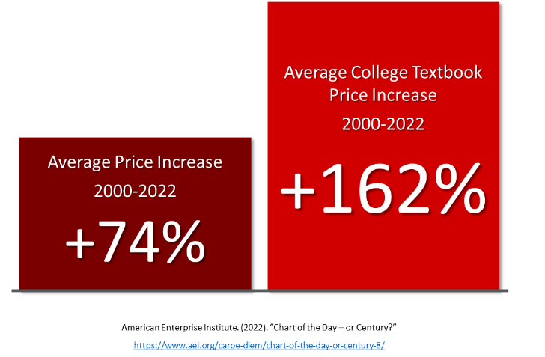
Why OER Advocacy Networks?
Systemwide mandates not an option
Networks build sustainable support
Rising textbook costs
“I didn’t buy groceries for 2 weeks so I could buy $400 worth of textbooks. Didn’t even use half of them for classes.”
Martoni, Charlene. (2023). “What Should Professors Know About Expensive Textbooks?” https://digitalcommons.kennesaw.edu/ato/2023openaccess/presentations/6/
Notes:
Networks are powerful because they rely on local leaders to build awareness and change.

Slide 6
The Origins of ALG
2008
White paper on textbook affordability & first USG Open textbook publication
ALG pilot team - librarians, instructional designers, & faculty worked with California State University's Affordable Learning Solutions
ALG launched in 2014 with state funding
eCore & USGShare - Collaborative online core initiative (eCore) materials repository
2013
2014
2011
Our Mission
Affordable Learning Georgia promotes student success and levels the playing field for all students through supporting the adoption, adaptation, and creation of affordable and open educational resources by USG faculty and professional staff.
https://affordablelearninggeorgia.org/timeline
Notes:
2008 - eCore & USGShare - The Office of Faculty Development began a repository to share eCore materials and allow faculty to share learning objects with each other at no cost. Due to server costs, USG Share was decommissioned in 2011.
2011 - White paper on textbook affordability & first USG Open textbook publication - The USG Report on Textbook Costs and Trends for Delivery and Cost Reduction was published with findings including the need for open textbooks in the USG. Read the report here.
2013 - ALG pilot team - A team of USG librarians, instructional designers, and faculty teamed up with members of the California State University's Affordable Learning Solutions, the first systemwide open education program, to develop plans for an initiative promoting the use of open and affordable materials. A logic model, a stakeholder analysis, and a website serving as a central hub for OER information were created.
2014 - ALG launched in 2014 with state funding - The first round of Textbook Transformation Grants involved 30 projects from 19 institutions where faculty replaced expensive materials with open and affordable materials.
Once ALG was funded, the question became: how do we reach all 26 institutions?

Slide 7
Why Create Champions?
Needed local advocates to bridge silos
Faculty trust peers more than mandates
Mandates weren’t an option so we had to build buy-in
Needed two-way communication between ALG and the campuses
Notes:
Needed local advocates to bridge silos
Faculty trust faculty, librarians, and IDs more than mandates
Mandates weren’t an option → had to build buy-in.
Built-in communication channel → campuses ↔ ALG
Champions = critical for outreach, awareness, and adoption
Champions are the bridge between a system initiative and everyday campus life.

Slide 8
The Champion Model
Faculty Champion – adoption, peer advocacy
Library Champion – curation, copyright, OER access
Design Champion – open pedagogy, instructional design
→Together - liaisons to ALG and advisors back to system
Notes:
It’s a triangle – each role strengthens the others.

Slide 9

Group Activity: Map Your Champions
Who in your state/system could serve in these roles?
?? → peer-to-peer adoption and advocacy
?? → curation, copyright, access
?? → open pedagogy, instructional design
??→ liaisons to system leadership
Notes:
Wearing multiple hats is a must in the early stages of any program start-up. Maybe you can’t start with three representatives at each college as advocates or champions. But let’s look at what is missing in your advocacy triangle.

Slide 10
How Champions Work
Monthly meetings with ALG (updates, recognition, guest speakers)
Host campus workshops, info sessions, and summits
Local point of contact for grants info & deadlines
Raise awareness with ALG brand & a local voice
Serve as connectors across silos (faculty/library/CETLs)
Open-ended volunteer role – we provide guidance, but Champions decide what their involvement looks like
Notes:
Champions are the trusted faces of ALG on campus – they make the system feel local.

Slide 11

Champion Impact
Supported grant proposals and compliance processes
Conducted info sessions & OER awareness campaigns
Helped institutions run OER Summits & events
Anecdotal but clear: ALG’s systemwide growth is tied to Champions’ local advocacy. Since 2014:
  $198M in student savings
  1.5M students impacted
  700+ affordable learning projects
https://www.affordablelearninggeorgia.org/about-us/our-impact
Notes:
We can’t always tie savings directly to Champions, but we know their advocacy drives adoption and momentum.

Slide 12
Supporting Champions
Current supports & resources:
Monthly meetings (updates, recognition, guest speakers, resource sharing)
Roadshow campus visits
Champion resources website & ALG newsletter
New Champion Welcome Training
Data & reporting
Planned support & resources:
Champion toolkits
Recognition & awards
ALG Awareness Week
Communities of Practice
Notes:
Support makes the difference between burnout and sustainability.

Slide 13
Why This Matters
Champions raise awareness in their own ways but with ALG brand and designation backing them
Champions are volunteers so recognition is key
System provides infrastructure; Champions bring it to life
Support makes the network sustainable
Notes:
ALG would be nowhere without its Champions – they are the cornerstone of the program.

Slide 14
group Activity: Reflection Questions
What kinds of impact would you want your network to have in its first 3 years?
What support structures would your network need to thrive?
→ Save your thoughts
Notes:
Think practical, low-barrier ideas (e.g., “host one OER info session,” “recruit a librarian + faculty member”

Slide 15
Designing Your Own Network
Core components to define:
Mission/values (affordability, equity, student success)
Structure (formal vs. grassroots, state vs. system)
Roles (Champions, coordinators, advisory group)
Communication strategies (listservs, summits, newsletters)
Practical strategies to start:
Begin with a pilot team
Offer onboarding/training
Provide incentives or small grants where possible
Celebrate early wins (data & stories)
Notes:
These principles can guide your own advocacy efforts, no matter your context.

Slide 16
Group Activity: Draft Your Design
In small groups: draft 3 steps to launch/support a network
  Keep in mind the roles you identified for peer-to-peer adoption; curation, copyright, access; pedagogy, instructional design; and liaisons to system leadership
  Use your reflections on the kinds of impact you would like to see and the kinds of support structures you think are needed.
Prepare to share one draft launch idea per group

Slide 17
Key Takeaways
Networks succeed where mandates fail
Champions are trusted local advocates
Impact grows when champions are supported & recognized
Structured roles + investment = statewide change
Notes:
What is one concrete step you can take when you return?

Slide 18

Resources
Download session materials at: https://alg.manifoldapp.org/projects/ache-oer-2025
  Slides
  Participant Handout
  Workshop Outline

Slide 19

Thank You
Nakita Afaha
Program Manager, Affordable Learning Georgia
706-583-2353
Nakita.Afaha@usg.edu
www.affordablelearninggeorgia.org
https://www.linkedin.com/in/nakita-afaha/

